Slide 1
THE INSTITUTION OF ENGINEERS(INDIA)
UP STATE CENTRE LUCKNOW.
RISK MANAGEMENT AND SAFETY AT WORK PLACE
BY
ER.H.S. MAURYA
ON 24TH AUG.2024

Slide 2
RISK MANAGEMENT
Risk management is the decision-making process through which choices can be made between a range of options which achieve the "required outcome". The "required outcome" may be specified by legislation by way of environmental standards, may be determined by a formalised risk-cost-benefit analysis or may be determined by another process for instance "industry norms" or "good practice". It should result in risks being reduced to an "acceptable" level within the constraints of the available resources.

Slide 3
What is risk management in engineering?
What is Engineering Risk Management? Risk management in engineering sees beyond the immediate needs and analyzes and adjusts for different risks and uncertainties that may come. Engineers have assisted communities in reducing the harmful impact of adverse events, from natural disasters to technological hazards.
Engineers are also concerned with political risk management of the projects.

Slide 4
Risks can be managed in many ways. They can be eliminated, transferred, retained or reduced. Risk reduction activities reduce the risk to an "acceptable" level, derived after taking into account a selection of factors such as government policy, industry norms, and economic, social and cultural factors.

Slide 5
It is important to note that although risk assessment is used extensively in environmental policy and regulation it is not without controversy. This is also true for risk management.

Slide 6
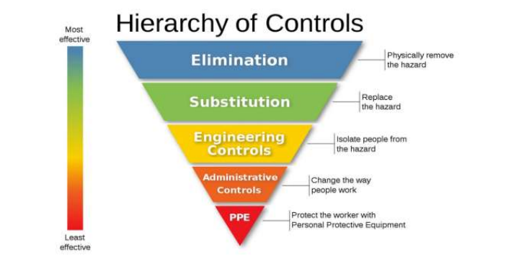

Slide 7
Concept
Rapid technological change, increasing scale of industrial complexes, increased system integration, market competition, and other factors have been shown to increase societal risk in the past few decades. As such, risk assessments become increasingly critical in mitigating accidents, improving safety, and improving outcomes. Risk assessment consists of an objective evaluation of risk in which assumptions and uncertainties are clearly considered and presented. This involves identification of risk (what can happen and why), the potential consequences, the probability of occurrence, the tolerability or acceptability of the risk, and ways to mitigate or reduce the probability of the risk

Slide 8
. Optimally, it also involves documentation of the risk assessment and its findings, implementation of mitigation methods, and review of the assessment (or risk management plan), coupled with updates when necessary. Sometimes risks can be deemed acceptable, meaning the risk "is understood and tolerated ... usually because the cost or difficulty of implementing an effective countermeasure for the associated vulnerability exceeds the expectation of loss.

Slide 9
Aim of Risk Management
Risk management is the identification, evaluation, and prioritization of risks followed by coordinated and economical application of resources to minimize, monitor, and control the probability or impact of unfortunate events or to maximize the realization of opportunities.

Slide 10
What is a risk assessment?
The definition of a risk assessment is a systematic process of identifying hazards and evaluating any associated risks within a workplace, then implementing reasonable control measures to remove or reduce them.
When completing a risk assessment, it is important to clearly define some keywords:

Slide 11
Some relevant Definitions
An accident is ‘an unplanned event that results in loss’
A hazard is ‘something that has the potential to cause harm’
A risk is ‘the likelihood and the severity of a negative occurrence (injury, ill-health, damage, loss) resulting from a hazard.’

Slide 12
Why are risk assessments important?
Risk assessment is a straightforward and structured method of ensuring the risks to the health, safety and wellbeing of employees (and others) are suitably eliminated, reduced or controlled.

Slide 13
The main purpose of risk assessments are:
To identify health and safety hazards and evaluate the risks presented within the workplace
To evaluate the effectiveness and suitability of existing control measures
To ensure additional controls (including procedural) are implemented wherever the remaining risk is considered to be anything other than low.
To prioritize further resources if needed to ensure the above.

Slide 14
IMPORTANCE OF RISK ASSESMENT
Risk assessments are carried out to formally identify hazards or risks involved to employees and others when carrying out a task. This helps the employer put into place adequate measures to protect people from harm. But the importance of not carrying out proper risk assessments goes beyond the fact that it creates negative image and publicity for the employer.

Slide 15
Risk assessment in the workplace
1. Risk assessments are crucial to preventing accidents in the workplace: not only can risk assessments reduce the likelihood of accidents, they also help raise awareness of hazards and minimize risk.
2. They reduce injuries and save lives: risk assessments don't just identify hazards that create short-term risks. Without an effective risk assessment, long-term risks such as exposure to asbestos wouldn't be identified or mitigated, potentially leading to fatal health problems.

Slide 16
3. They help generate awareness about hazards in the workplace: organisations and employers being aware of hazards means injury is less likely to occur. Not only does this keep everyone safe and well but it will additionally save the company or organisation money. Injured employees may require sick pay, time off and compensation.
4. They help managers to make decisions about risk, including identifying who is most at risk and making appropriate adjustments: having an effective and formal risk assessment in place will demonstrate that you have taken appropriate measures to ensure the health and safety of your employees.

Slide 17
Who is responsible for carrying out risk assessments?
It is the responsibility of the employer (or self-employed person) to carry out the risk assessment at work or to appoint someone with the relevant knowledge, experience and skills to do so.
An employer must take reasonable steps ‘for the effective planning, organisation, control, monitoring and review of the preventive and protective measures.’ So even if the task of risk management is delegated, it is ultimately the responsibility of the management within any business to ensure it is effectively completed.

Slide 18
Once hazards have been identified, the associated risks evaluated and steps taken to minimize the potential effects, the next step for an employer is to clearly and effectively communicate the risk assessment process and content to relevant parties.
The process of communication is more effectively achieved if the relevant persons are involved with the risk assessment process at every stage. The person carrying out an activity or task is often best placed to provide details on the associated hazards and risks and should participate fully in the completion of the risk assessment.

Slide 19
How to do a risk assessment?
The HSE(Health,Safety and Environmet) has recommended a five-step process for completing a risk assessment. This provides a useful checklist to follow and to ensure that the assessment is suitably comprehensive. It involves:

Slide 20
Identifying potential hazards
Identifying who might be harmed by those hazards
Evaluating risk (severity and likelihood) and establishing suitable precautions
Implementing controls and recording your findings
Reviewing your assessment and re-assessing if necessary.

Slide 21
Step 1. Identify potential hazards
It is important to firstly identify any potential hazards within a workplace that may cause harm to anyone that comes into contact with them. They may not always be obvious so some simple steps you can take to identify hazards are:
Observation: Walking around your workplace and looking at what activities, tasks, processes or substances used could harm your employees (or others)
Looking back over past accidents and ill-health records as they may identify less obvious hazards
Checking manufacturers’ data sheets, instructions, information and guidance
Consulting with employees (and others) who are carrying out the activities, tasks or processes.
It may be useful to group hazards into five categories, namely physical, chemical, biological, ergonomic and psychological.

Slide 22
Step 2. Identify who might be harmed by those hazards
Next, identify who might be harmed by those potential hazards. It should also be noted how they could be affected, be it through direct contact or indirect contact. It is not necessary to list people by name, rather by identifying groups including:
Employees
Contractors
Some hazards may present a higher risk to certain groups including children, young people, new or expectant mothers, new employees, home workers, and lone workers.

Slide 23
Step 3. Evaluate risk severity and establish precautions
After identifying any hazards and who might be affected, it is important to evaluate the severity the risk may present (should it occur) and establish suitable and effective controls to reduce this level of risk as far as is ‘reasonably practicable’. This means that everything possible is done to ensure health and safety considering all relevant factors including:

Slide 24
Likelihood that harm may occur
Severity of harm that may occur
Knowledge about eliminating, reducing or controlling hazards and risks
Availability of control measures designed to eliminate, reduce or suitably control the risk
Costs associated with available control measures designed to eliminate, reduce or suitably control the risk

Slide 25
Assessing the severity of a risk requires an evaluation of the likelihood of an occurrence and how substantial the consequences that it may cause. Some factors affecting this evaluation include the duration and frequency of exposure, number of persons affected, competence of those exposed, the type of equipment and its condition, and availability of first-aid provisions and/or emergency support.

Slide 26

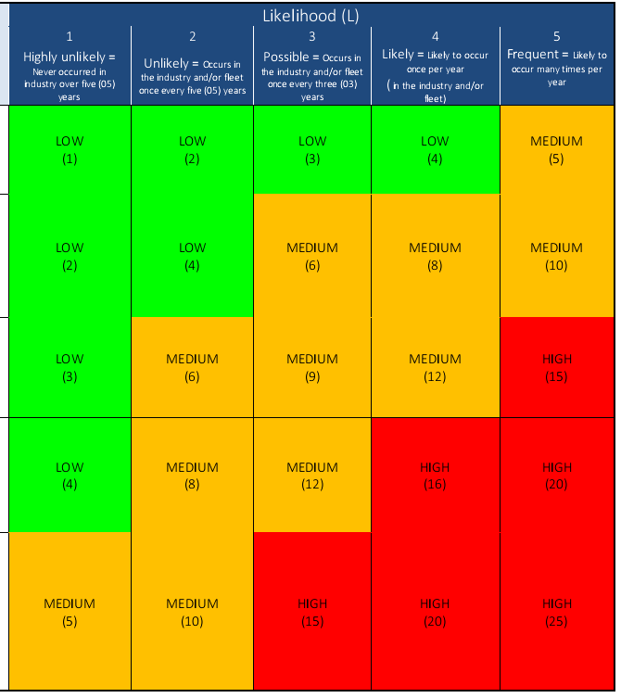
RISK MATRIX

Slide 27
Step 4. Implement changes and record your findings
If a workplace has five or more individuals, significant findings of the risk assessments are required to be kept either electronically or in writing. Recording your findings on a risk assessment form is an easy way to keep track of the risks and control measures put in place to reduce the identified risk. The form includes:

Slide 28
What hazards were found
Person(s) or groups affected
The controls put in place to manage risks and who is monitoring them
Who carried out the assessment
On what date the assessment was done.

Slide 29
It is sensible to ensure the risk assessment is proportionate to the activity or task being carried out and this can often be a straightforward process for generic tasks.

Slide 30
Step 5. Review your assessment and reassess if necessary
Employers should periodically review the assessment and if necessary, re-assess any controls in place.
A good guide as to when you may need to review your processes are:

Slide 31
After any significant change within the workplace or process in question
After an accident or ill-health incident has occurred
After near-misses have been reported.

Slide 32
Forgetting to review your risk assessment is easy, especially when trying to run a business. Don't wait until it's too late, set a date to review your risk assessment when you're conducting it and don't forget to add the date to your diary.
Significant changes can happen in businesses and when they do, make sure to review your risk assessment and amend it if you need to. If you or your organisation are planning changes that will happen in the future, ensure a risk assessment review is included.

Slide 33
What documentation do you need?
It is a misconception that risk assessments inherently involve a vast amount of paperwork. It can be as straight forward as completing a basic risk assessment form for many generic tasks or activities.
However, employers should make sure they record significant findings including:

Slide 34
Any hazards identified
What controls are in currently in place, and information on any further control measures that may be required
Any individuals that have been identified as being especially at risk.

Slide 35
There is no set amount of time that you are required to retain the risk assessment, but it is best practice to keep it as long as is considered relevant to a particular task or activity.
Risk assessments are an integral part of ensuring the health, safety and wellbeing of everyone within the workplace.

Slide 36
SAFETY CHECK LIST
What is a safety checklist?
A safety checklist is typically a tool that allows professionals to receive a broad overview of safety practices, behaviors, and risks inside a workplace or department. Its primary purpose is to remind individuals of the areas to inspect and which details are critical for safety.
This can only be prepared correctly, if the Risk Assessment has been performed taking into account all the Risk possibilities, which are present or may occur during the ongoing process.

Slide 37
Risk assessment
Risk assessment determines possible mishaps, their likelihood and consequences, and the tolerances for such events. The results of this process may be expressed in a quantitative or qualitative fashion. Risk assessment is an inherent part of a broader risk management strategy to help reduce any potential risk-related consequences.
More precisely, risk assessment identifies and analyses potential (future) events that may negatively impact individuals, assets, and/or the environment (i.e. hazard analysis). It also makes judgments "on the tolerability of the risk on the basis of a risk analysis" while considering influencing factors (i.e. risk evaluation).

Slide 38
Process
Older textbooks distinguish between the term risk analysis and risk evaluation; a risk analysis includes the following 4 steps:
Context,establish the context, which restricts the range of hazards to be considered. It is also necessary to identify the potential parties or assets which may be affected by the threat, and the potential consequences to them if the hazard is activated.
Hazard identification, an identification of visible and implied hazards and determining the qualitative nature of the potential adverse consequences of each hazard. Without a potential adverse consequence, there is no hazard.
frequency analysis If a consequence is dependent on dose, i.e. the amount of exposure, the relationship between dose and severity of consequence must be established, and the risk depends on the probable dose, which may depend on concentration or amplitude and duration or frequency of exposure. This is the general case for many health hazards where the mechanism of injury is toxicity or repetitive injury, particularly where the effect is cumulative.

Slide 39
consequence analysis. For other hazards, the consequences may either occur or not, and the severity may be extremely variable even when the triggering conditions are the same. This is typical of many biological hazards as well as a large range of safety hazards. Exposure to a pathogen may or may not result in actual infection, and the consequences of infection may also be variable. Similarly, a fall from the same place may result in minor injury or death, depending on unpredictable details. In these cases, estimates must be made of reasonably likely consequences and associated probability of occurrence.
A risk evaluation means that judgements are made on the tolerability of the identified risks, leading to risk acceptance. When risk analysis and risk evaluation are made at the same time, it is called risk assessment.

Slide 40
Health and Safety Inspection Checklists for the Workplace
Workplace health and safety are important standards to recognize and maintain, regardless of industry. Professionals can use many types of Occupational Safety and Health Administration-compliant safety inspection checklists to mitigate risk and promote well-being at work. With proper safety regulations, employees can feel confident and comfortable in their work environments and excel in their duties.

Slide 41
What is a safety inspection checklist?
Safety inspection checklists are tools professionals from various industries use to conduct safety examinations and tests. The Occupational Safety and Health Administration (OSHA) sets the standards for most safety checklists used on job sites across various industries in the United States. These checklists help determine whether a work site is safe for employees and if there are any existing workplace hazards. Regular safety checklists allow professionals to identify potential risks, such as equipment failures or chemical exposures, expediently. From here, they can take action to protect themselves and their colleagues by mitigating or removing hazards.

Slide 42
Factors Affecting Risk Assessment
The risk assessment may include an evaluation of what the risks mean in practice to those effected. This will depend heavily on how the risk is perceived. Risk perception involves people's beliefs, attitudes, judgements and feelings, as well as the wider social or cultural values that people adopt towards hazards and their benefits. The way in which people perceive risk is vital in the process of assessing and managing risk. Risk perception will be a major determinant in whether a risk is deemed to be "acceptable" and whether the risk management measures imposed are seen to resolve the problem.

Slide 43
Benefits of safety inspection checklists
Safety checklists are important tools that help workplaces promote employee well-being and manage potential occupational hazards. There are some significant benefits that employees may enjoy from implementing the use of safety inspection checklists in their workplace, including:

Slide 44
Risk assessment is carried out to enable a risk management decision to be made. It has been argued that the scientific risk assessment process should be separated from the policy risk management process but it is now widely recognised that this is not possible. The two are intimately linked.

Slide 45
Promoting safety
: Inspection checklists can help workplaces maintain safety across all processes. The regular use of checklists may also foster a general sense of commitment to workplace health and safety among employers and employees alike.

Slide 46
Fostering responsibility
Safety inspection checklists can help employees foster a sense of ownership over workplace well-being. When internal stakeholders maintain a safety standard, the overall investment in safety within a workplace may increase.

Slide 47
Increasing productivity
: When employees don't have to worry about encountering risks and hazards in their daily activities, they can focus their energy on meeting specific goals and completing tasks. Therefore, the use of safety inspection checklists can help boost productivity in the workplace.

Slide 48
Mitigating risk
Using safety inspection checklists allows workplaces to mitigate potential risks and harm to employers and employees. Checklists can help professionals identify hazards early in their lifespan and address them quickly to maintain occupational safety.

Slide 49
Improving employee satisfaction
For employees to feel satisfied with their jobs, it's integral for them to feel safe in the workplace. Employees may feel more secure in their roles when work sites are purposeful in maintaining workplace safety and protection through inspection checklists.

Slide 50
THANK YOU

