Slide 1
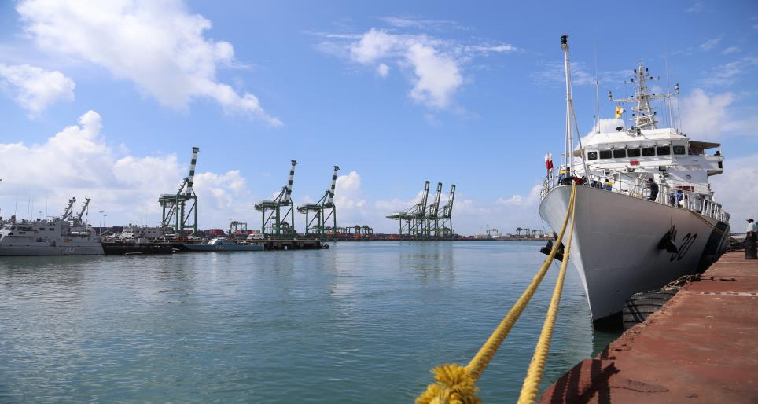

MARITIME INDIA SUMMIT 2016
NATIONAL MARITIME DAY 2024
Institution of Engineers (India),
UP State Centre, Lucknow Presented by
05th April 2024 Er. Samir K Jain

Slide 2
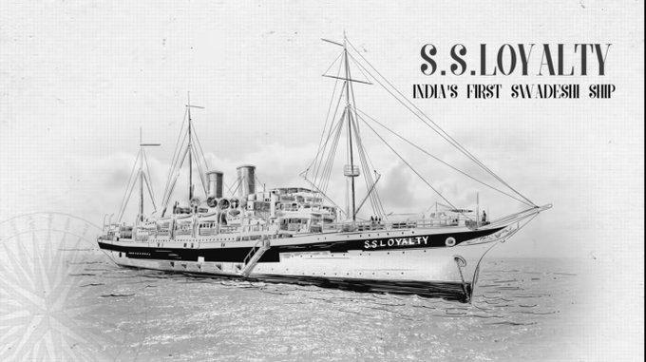
History of National Maritime Day
Indian National Maritime Day is observed on 5th April every year to commemorate the maiden voyage of MV Loyalty, India's first merchant ship, on that day in 1919. The day is celebrated to highlight the importance of the maritime sector to the country's economy and to recognize the contributions of the Indian seafarers.
12

Slide 3
Shipping: Main features
Benefits of trade thru shipping transport–
  Economical for Long distance (ex, over 400km) and large volumes
  Most Environmentally friendly transport mode
  ✓ CO2 emissions of shipping is 1/6 compared to that of road transport
  Connect mainland and islands
Shipping has big potential, but it is less utilized in India
  Insufficient port infrastructure & hinterland connectivity
  Business practices based on road-oriented transport systems - Lack of policies and incentives to promote coastal shipping & IWT
  Strict environmental regulations including GHGs Emission
  Highly volatile operating/management cost
12

Slide 4
Theme of National Maritime Day
Sustainable Shipping - Challenges
Sustainable Shipping - Opportunities
12

Slide 5
Sustainable Shipping - Challenges
Reduction of its carbon footprint
Enforcement of environmental regulations- insufficient readiness
Maritime security
Inadequate infrastructure, especially coastal and domestics shipping
Intensifying competition and low profitability
12

Slide 6
Sustainable Shipping - Challenges
Why is carbon footprint reduction a major concern for the shipping industry?
12

Slide 7
Sustainable Shipping - Challenges
Although it is a critical pillar of the global economy, moving such amount of goods around the globe requires roughly 300mn metric tons of dirty fossil fuels per year.
This process generates approximately 1bn metric tons of carbon dioxide emissions, though the amount of carbon emission looks enormous, it is only equal to as much as some countries’ annual greenhouse gas emissions i.e. Japan.
As per International Maritime Organization (IMO), the emissions from merchant’s vessels is increasing which is 30% above their 2008 level.
12

Slide 8
Sustainable Shipping - Challenges
In 2018, the IMO has committed to achieve net zero GHG emissions by 2050 in order to comply with the Paris climate agreement (aims to limit global temperature rise this century to 2 degrees Celsius while making best efforts to keep it to 1.5 degrees Celsius)
For a sustainable change in a ship’s emission, regulations are being made stricter for which shipping industry is not fully ready yet.
The ultimate goal of all initiatives by IMO is to bring down emission level by 20%-30% by 2030 and 70%-80% by 2040 in carbon dioxide emissions – in comparison to 2008 levels.
Energy Efficiency Existing Ship Index (EEXI) is made mandatory for all larger vessels (400 GT or more).
As per EEXI standards, all vessels are being examined on an emissions scale of A to E
12

Slide 9
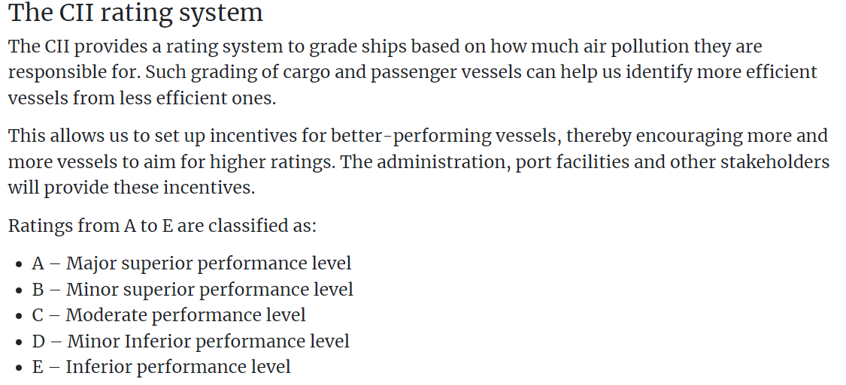
Sustainable Shipping - Challenges
12

Slide 10
Sustainable Shipping - Challenges
Vessels in the A to C grade will be granted a certificate (International Energy Efficiency Compliance Certificate) which is required for any ship to trade.
Those ships, falling into the D and E grade need to declare a set of actions by which they will achieve A to C grades on energy efficiency.
European Union (EU) has specified recently that for all ships calling EU ports or plying within its waters, a 55% reduction in carbon emissions, compared to 1990 levels, will be mandatory by 2030.
In April 2022, the United States agreed to seek a zero-emission shipping industry by 2050
12

Slide 11
Sustainable Shipping – Challenges
***Use of alternative fuels***
Aware of growing environmental alarms, vessel builders and owners are considering alternative energy sources for their fleets.
International shipping business research and developments are focusing on liquid natural gas (LNG), liquefied petroleum gas (LPG), hydrogen, ammonia, methanol, or even solar energy and wind power to decrease their environmental impacts.
Such transformation comes with a number of issues related to quality, safety, and reliability for use on commercial vessels, scaling and broad deployment, costs, and availability.
12

Slide 12
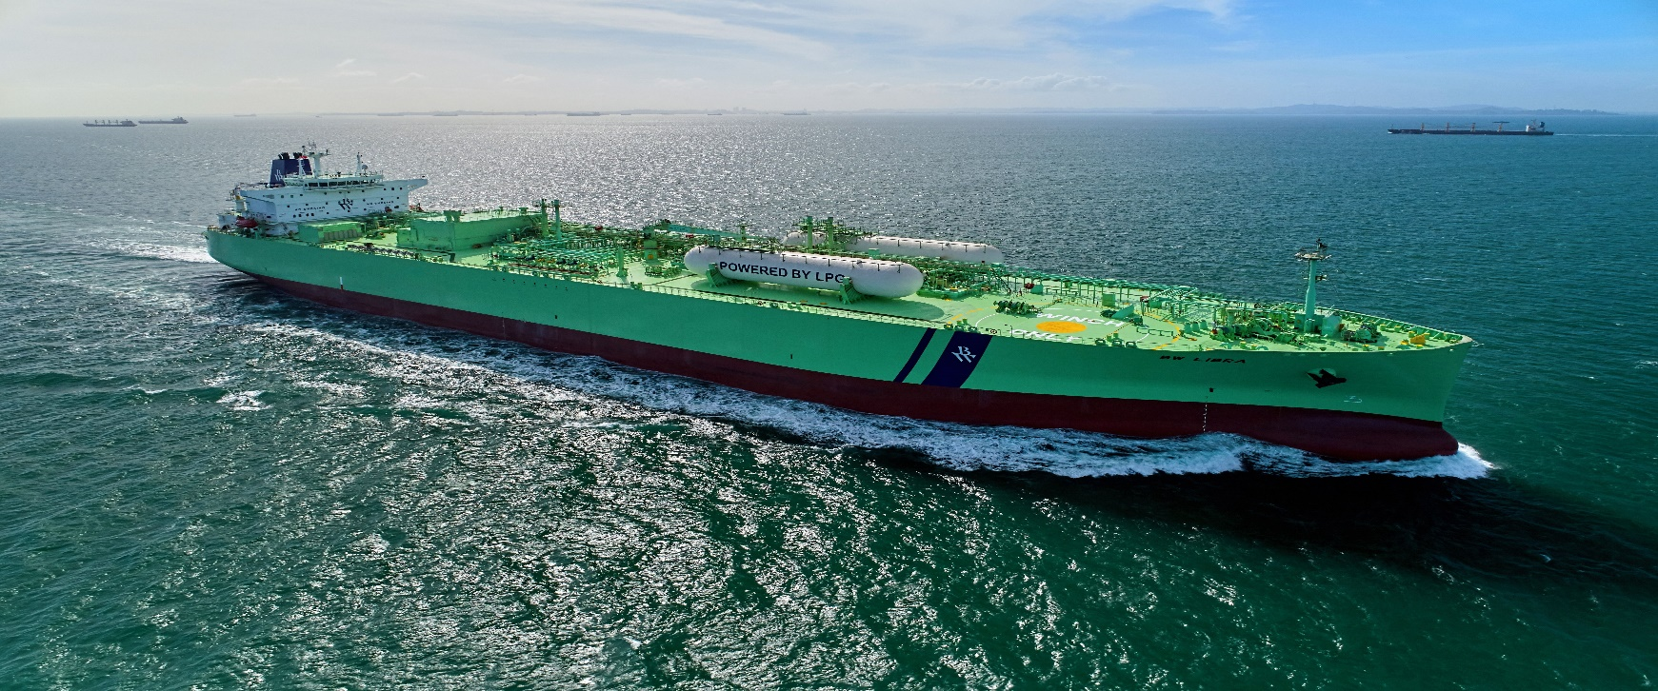
Sustainable Shipping – Challenges
***Use of alternative fuels***
12

Slide 13
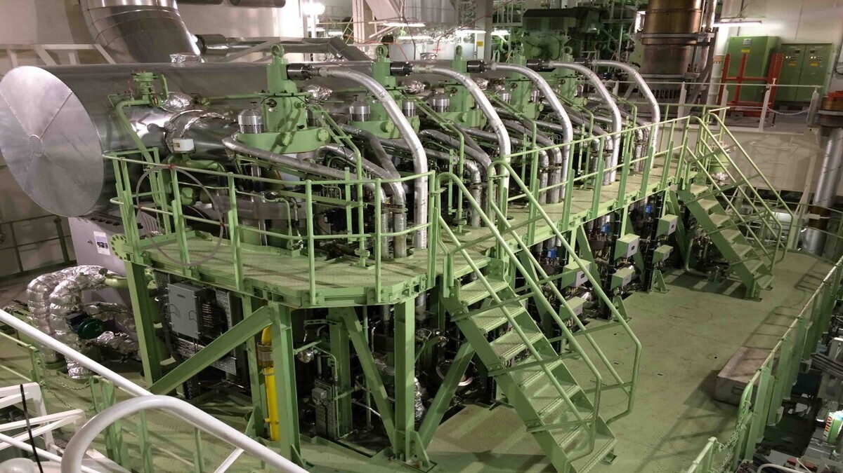
Sustainable Shipping – Challenges
***Use of alternative fuels***
12

Slide 14
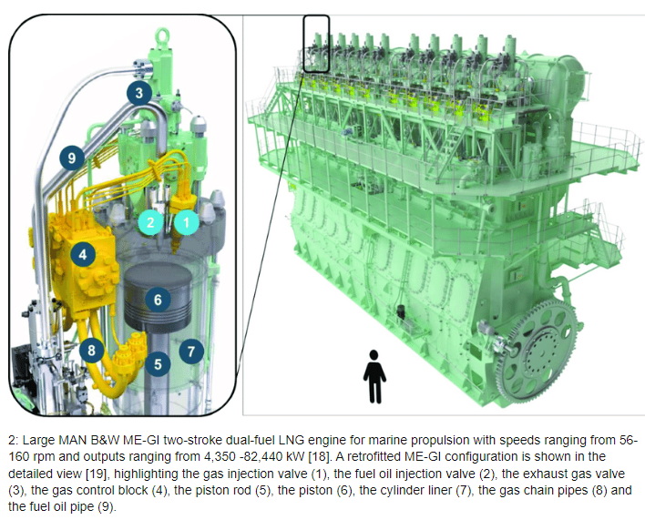
Sustainable Shipping – Challenges
***Use of alternative fuels***
12

Slide 15
Sustainable Shipping – Challenges
***Use of alternative fuels***
The zero-carbon fuels have to be widely available with the needed infrastructure so that vessel operators can easily use them.
Hydrogen, in particular, has a very low energy density as opposed to oil, meaning that any ship using it, has to carry much higher volumes of fuel or be replenished more often.
Ammonia is toxic to humans and marine life, thus raising safety and environmental alarms.
While green methanol can be retrofit into existing ships, it will need more modifications even for those who use dual fuels.
Vessel crews need to be proficient in handling these new sources of energy.
12

Slide 16
Sustainable Shipping – Challenges
***Optimization of fuel consumption***
  Historical and real-time data gathered from vessels, information from satellite observation and other sources are analyzed to determine the best routes and speed.
  This process reduces fuel consumption and lessens greenhouse gas emissions into the atmosphere.
  Slow steaming is another cost-effective approach to consume less fuel.
  By speed reduction of 25% decreases fuel consumption by 58% and lessens the emissions of carbon dioxide, SOx, and Nox.
12

Slide 17
Sustainable Shipping – Challenges
Maritime Cyber Security
12

Slide 18
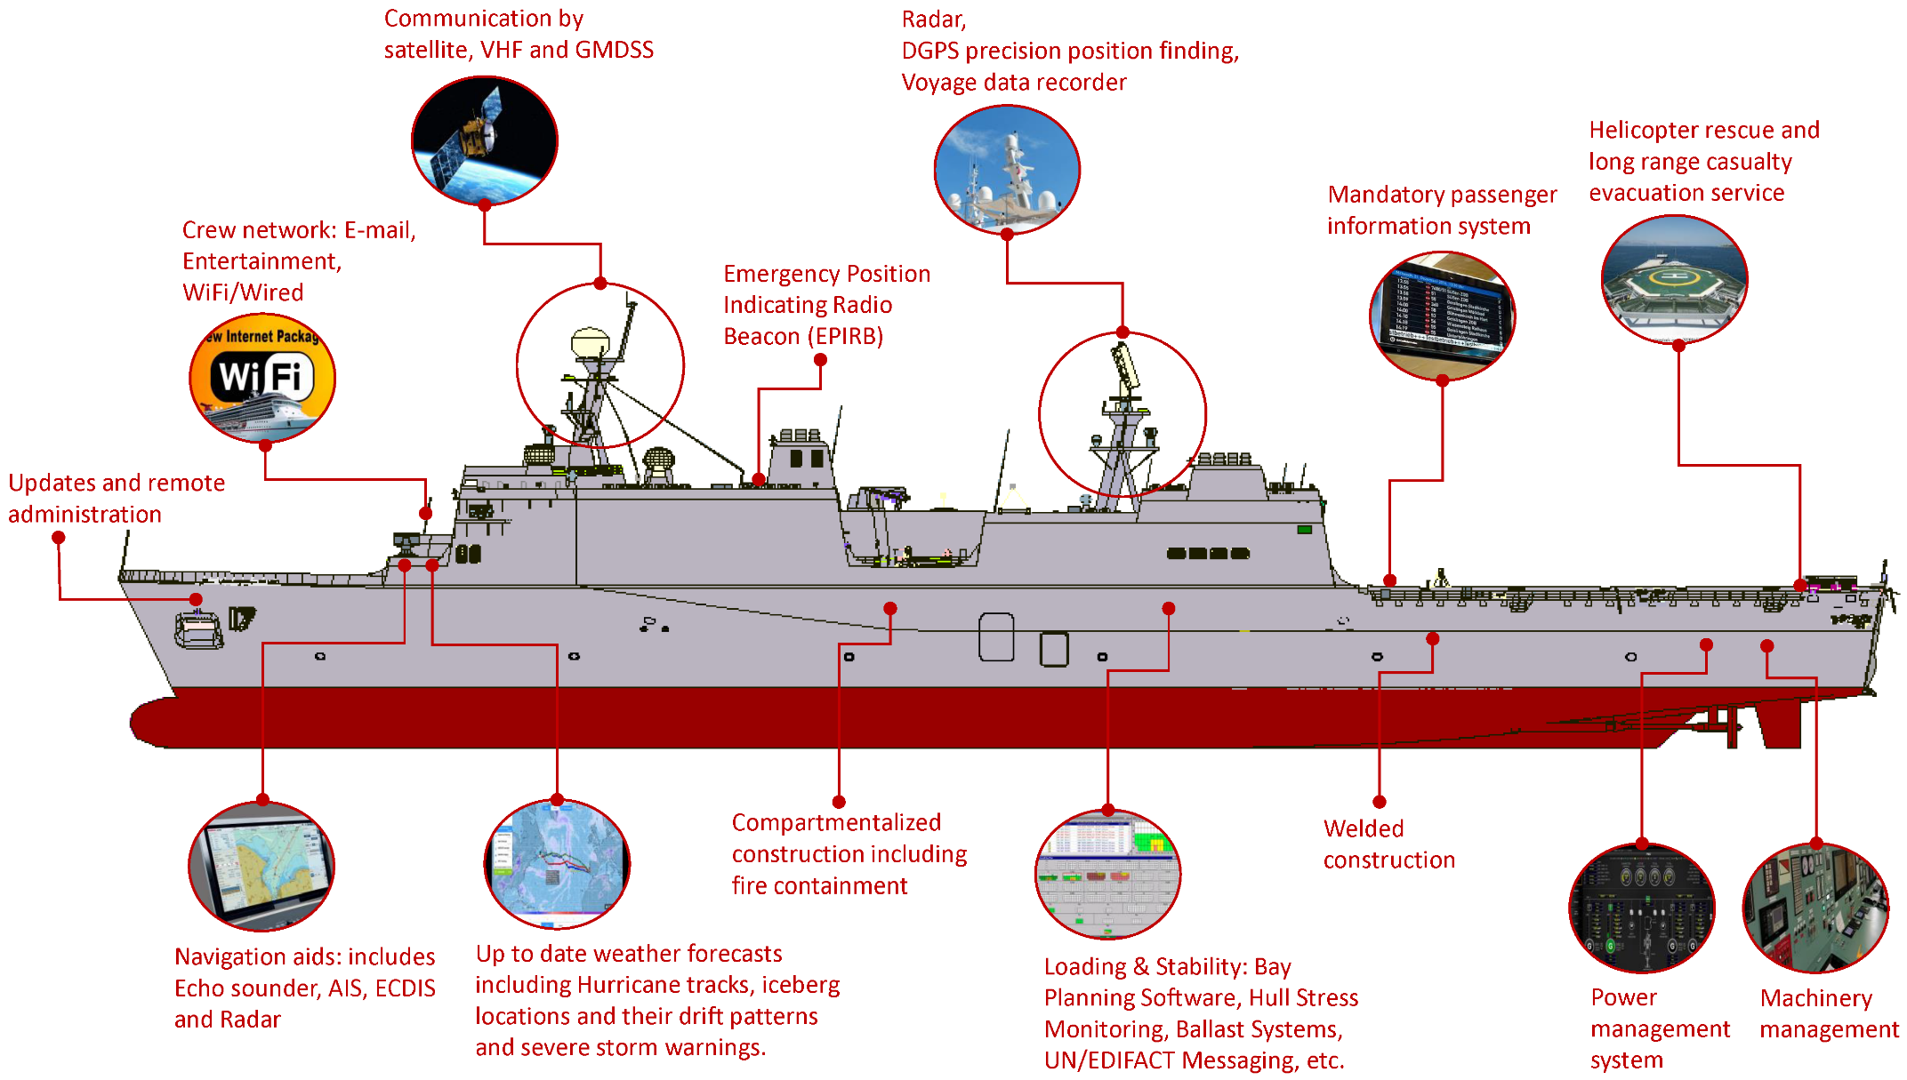
Sustainable Shipping – Challenges
Maritime security (Equipment on Vessels)
12

Slide 19
Sustainable Shipping – Challenges
Maritime Cyber security
Cyber attacks have been rapidly increasing over the years, resulting to:
big financial losses
regulatory sanctions
reputation and trust.
The maritime sector, which until now was considered safe due to the lack of Internet connectivity and the isolated nature of ships out at sea, is showing a big increase in cyber security breaches on operational technology as it enters the digital era.
12

Slide 20
Sustainable Shipping – Challenges
Maritime Cyber security
There are some possible countermeasures that can mitigate potential cyber attacks and make the shipping industry a hard target, such as the implementation of a new security standard that reduces the number and scope of cyber attacks.
However, many security challenges remain unresolved, especially with the increased use of automation and devices directly connected to web.
12

Slide 21
Sustainable Shipping
Opportunities
12

Slide 22
Development of coastal and inland waterways
Why now ?
Objective
  Rich heritage of maritime trade
    Rivers were lifeline of Indian economy, ports were gateways
    Trade and cultural ties with Asia and Africa by maritime route
    Ports such as Tamralipta, Poompuhar, Muziris, Calicut and Dwarka
  Increasing role of India in modern global trade – exports to grow through Make in India
  Robust growth in economy, poised to take full advantage of lower logistics costs by water routes
  Successful model for private sector participation
  Create awareness of untapped potential of the sector
  Engage all stakeholders on the roadmap for coastal and waterways development
  Showcase tangible investment opportunities and attract investors
    New ports and port expansion
    Road and rail connectivity
    Inland waterways
    Coastal industrial clusters
    Maritime tourism

Slide 23
Coastal Shipping (Long coastline of 7,517 km)
Cost for coastal shipping is INR 0.2-0.3 per tonne km compared to INR 1.5 for railways and INR 2.5 for road
Coal, cement, POL, food grains, steel and fertilizers are the key commodities with significant growth potential
Potential to lower logistics cost in the economy by INR 21,000-27,000 Cr by 2025
Coastal shipping can be a catalyst for coastal industrial clusters
Coal
Cement
Food
Grains
Steel
Fertilizer
12

Slide 24
Navigable Inland Waterways (14,000 km)
Reduce logistics cost of inland transport, relieve congestion on roads and railways
Support manufacturing activities in hinterland states
4 waterways currently under development: Ganga, Brahmaputra, Mahanadi, Buckingham Canal
NW1 already in use for coal transport from Haldia to Farakka
National Waterway 1
National
Waterway 2
Dhamra
Kolkata/Haldia
National Waterway 5
Paradip
National Waterway 4
Machilipatnam

Slide 25
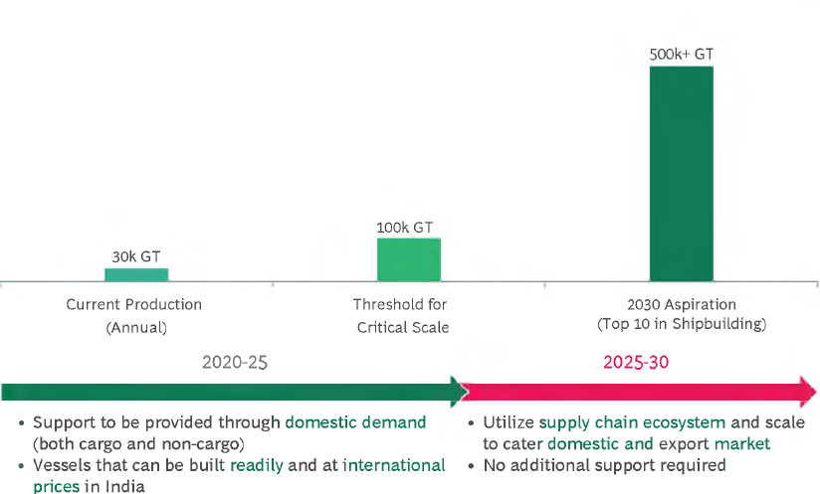
India’s Ship Building Vision 2030

Slide 26
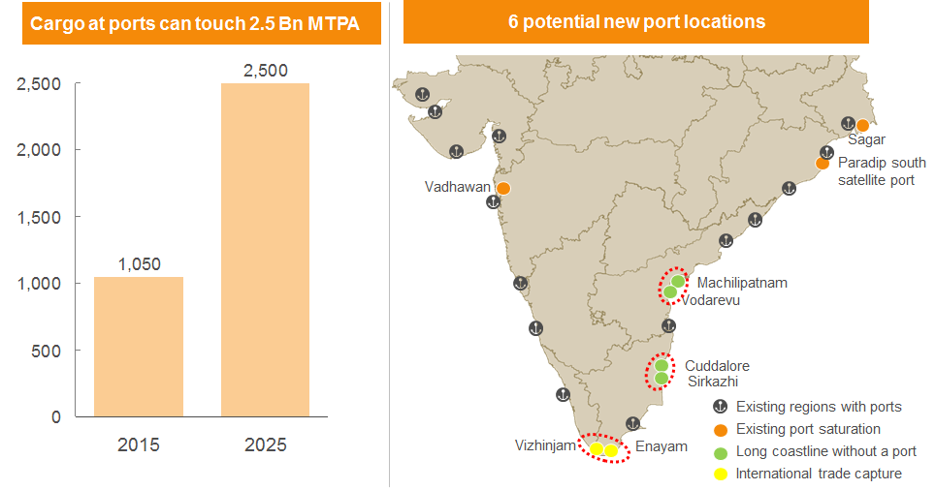
Capacity required to handle cargo to increase from ~1Bn MTPA to 2.5 Bn MTPA by 2025
‘Sagarmala’ – Linking Ports and Industrialization
10

Slide 27
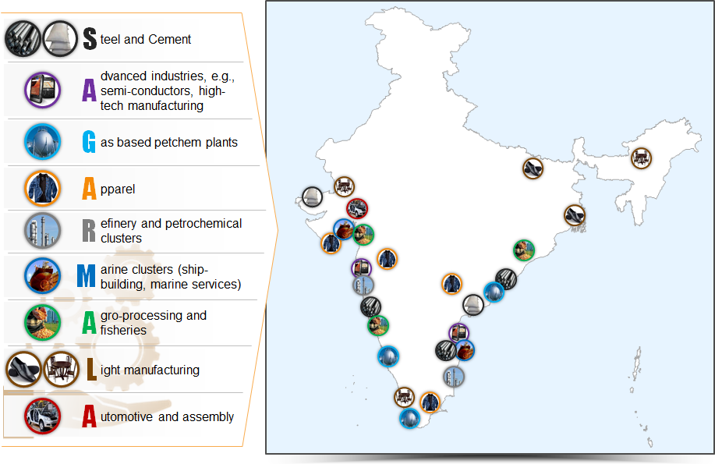
‘Sagarmala’ – Linking Ports and Industrialization
11

Slide 28
Investment Opportunities under ‘Sagaramala’
Type of projects
Number of projects
New greenfield port
  6 ports
New berths in major ports
  52 projects
Roads, railways, pipelines
  70+ roads, rail and pipeline projects
Multimodal logistic hubs
  7 dry ports
Inland waterways
  4 priority inland waterways
Port linked clusters
  14 energy and material clusters
  13 discrete clusters
Maritime tourism
  17 potential domestic circuits identified

Slide 29
MARITIME INDIA SUMMIT 2016
Thank You

