Slide 1
ADVANCEMENT IN MARINE ENGINEERING WRT GHG

Slide 2
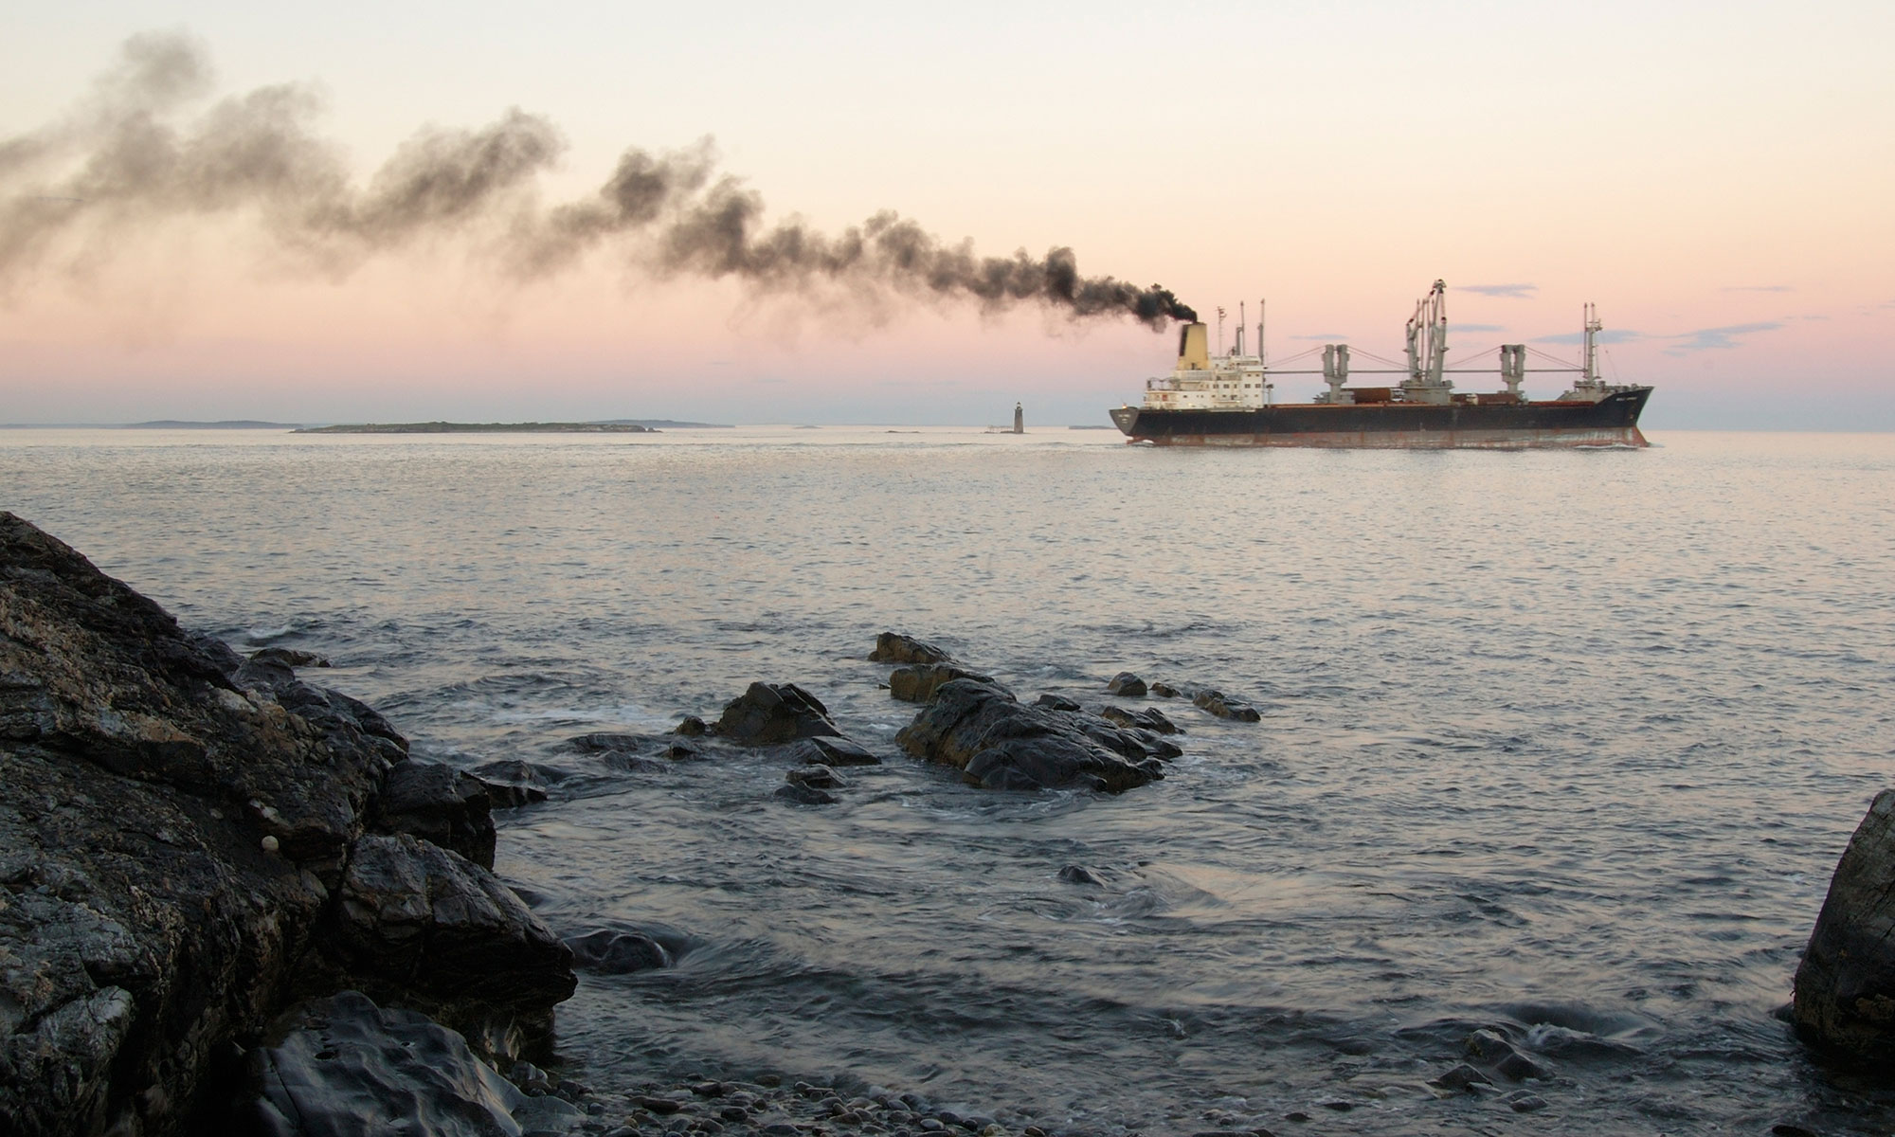

Slide 3
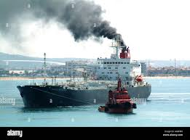

Slide 5
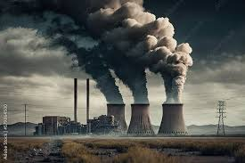

Slide 6
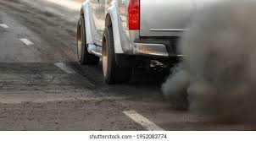

Slide 7
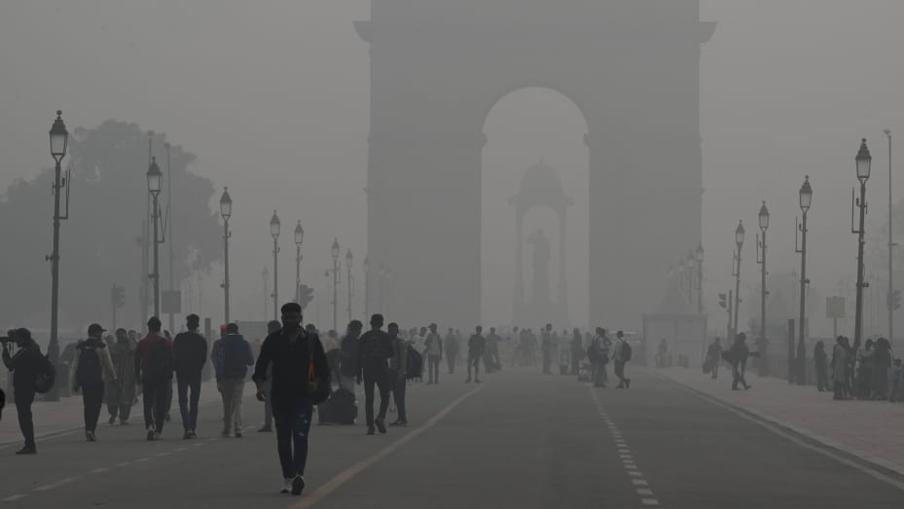
Thick layer of smog on Kartavya Path , November 5, 2023 in New Delhi, India.

Slide 8
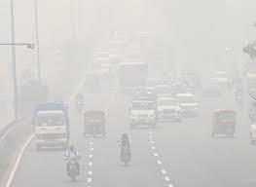

Slide 9
The term “smog” was coined in the early 1900s to describe the mix of smoke and fog caused by burning coal in industrial areas.
Smog is a visible type of air pollution that contains a mixture of pollutants, including particulate matter (PM), ground-level ozone (O3), carbon monoxide (CO), volatile organic compounds (VOCs), nitrogen oxides (NOx), and sulfur dioxide (SO2). It often appears as a brownish-yellow mist.

Slide 10
Ships move more than 80% of the world’s goods.
When it comes to transporting goods globally, two prominent modes stand out: sea and air, with the former accounting for more than 80% of trade volumes.
In terms of carbon footprint, sea freight has a clear advantage over air freight. Estimates suggest that shipping by sea produces approximately 15 to 25 times fewer CO2 emissions per kilogram-kilometer compared to air transportation.

Slide 12
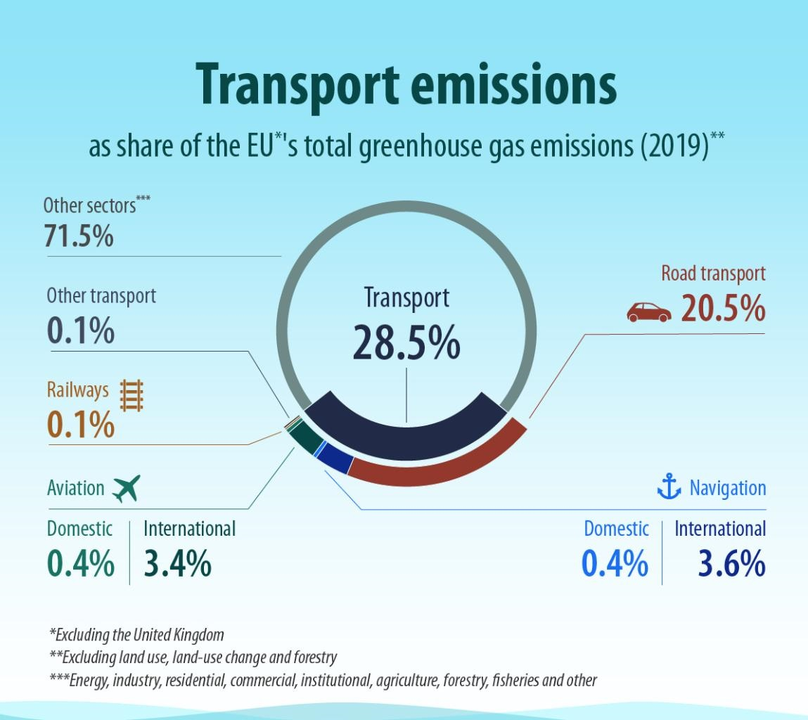

Slide 13
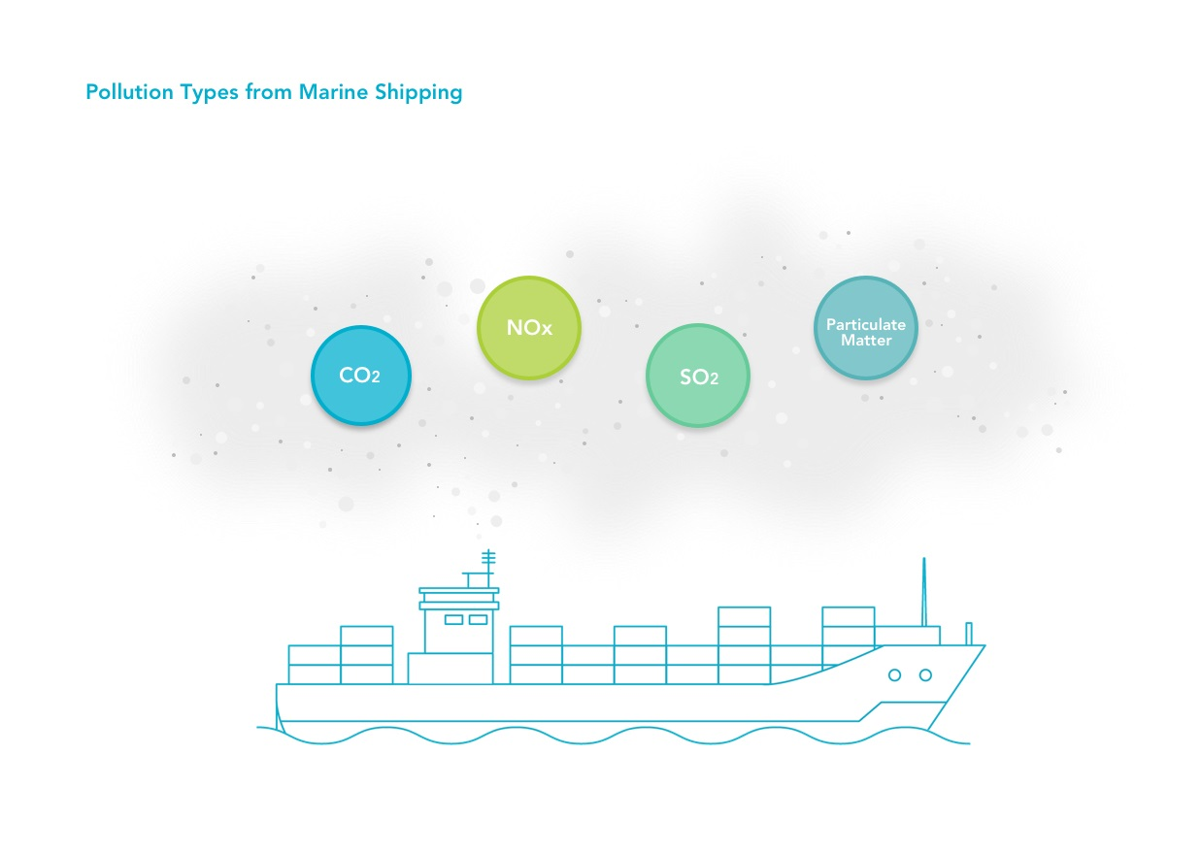

Slide 14
Greenhouse Gas (GHG)
Primary GHG emissions include carbon dioxide (CO₂), methane (CH₄), and nitrous oxide (N₂O), which contribute to climate change and ocean acidification.
GHG contributes to widespread climate change by trapping the sun’s heat.
Climate change-induced extreme weather events such as heat waves, floods and major storms.
When CO₂ is absorbed by seawater, the water becomes more acidic. This increase in acidity has adverse effects on marine life and ecosystems.

Slide 15
Nitrogen Oxides (NO_{x})
A collection of gases of various combinations of nitrogen and oxygen that:
Cause lung inflammation when breathed, NO_{x} may enter the bloodstream and with long-term exposure lead to eventual heart and lung failures.
Interact with volatile organic compounds (VOCs) to create ground-level ozone, which contributes to eye, nose and throat irritations; shortness of breath; worsening of respiratory conditions; chronic obstructive pulmonary disease; asthma and allergies; cardiovascular disease and premature death.
Cause acidification of soil and water (acid rain).
Decrease crop and vegetation productivity due to ground-level ozone, threatening food security.

Slide 16
Sulphur Oxides (SO_{x})
A collection of gases of various combinations of sulphur and oxygen that:
Cause lung inflammation when breathed, increasing susceptibility to allergens in people with asthma. SO_{x} and may enter the bloodstream and with long-term exposure lead to eventual heart and lung failures.
Cause eye irritation, increased susceptibility to respiratory tract infections, and increased hospital admissions for cardiac disease.
Cause acidification of soil and water (acid rain).

Slide 17
Particulate Matter
A collection of solid and liquid particles formed during fuel combustion that:
Can be inhaled into people’s lungs and then absorbed into the bloodstream, which has been linked to many negative heart and lung health outcomes, including cancers.
Are a component of smog.
Form “black carbon”, the second largest contributor to climate change after CO₂. While airborne, black carbon absorbs solar energy and contributes to atmospheric warming.

Slide 18
In April 2018, the IMO adopted an initial strategy to reduce ship-source GHG, intended to reduce total annual emissions by at least
50% (compared to 2008 levels) by 2050.
This strategy was revised in July 2023 to commit the shipping industry to reach
net-zero emissions by or around 2050.

Slide 19
Regulations
From 1 January 2020, the global Sulphur limit in fuels being used on ships has been reduced from
3.50% to 0.50%
For vessels operating in Sulphur Emission Control Areas (SECA) under MARPOL, the limit, which will remain unchanged, has been
0.10%
since 1 January 2015.

Slide 20
Emission Control Areas
ECAs are established by the IMO to limit emissions from ships in coastal areas. In North America’s ECA, ships must burn fuel or scrub exhaust to emit a maximum of
0.1% sulphur
content since January 2015.

Slide 21
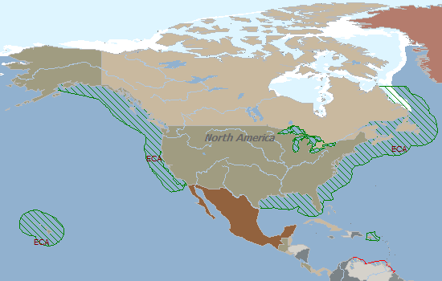
The United States, Canada and the United States Caribbean Sea area

Slide 22
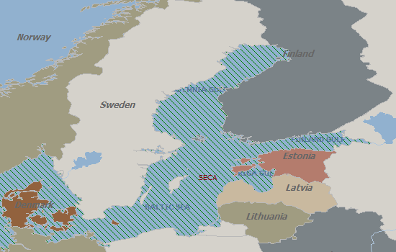
The Baltic sea Area

Slide 23
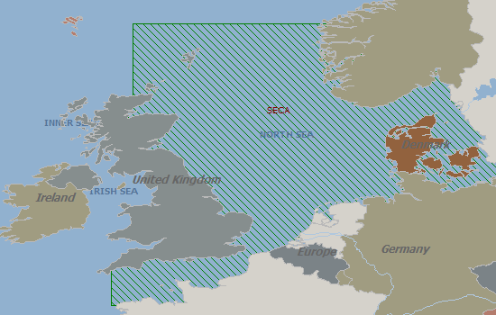
The North Sea area

Slide 24
These areas and ports are regulated as ECA by each country's national law. All vessels should use low sulfur bunker in these areas and ports. S<0.1%
Eu: ALL PORTS
Austria(AT), Belgium(BE), Bulgaria(BG), Croatia (HR), Cyprus(CY), Czech Republic(CZ), Denmark(DK),
Estonia(EE),
Finland(FI), France(FR), Germany(DE), Greece(GR), Hungary(HU), Ireland(IE), Italy(IT), Latvia(LV),
Lithuania(LT),
Luxembourg(LU), Malta(MT), The Netherlands(NL), Poland(PL), Portugal(PT), Romania(RO),
Slovakia(SK), Slovenia(SI),
Spain(ES), Sweden(SE), United Kingdom(GB)

Slide 25
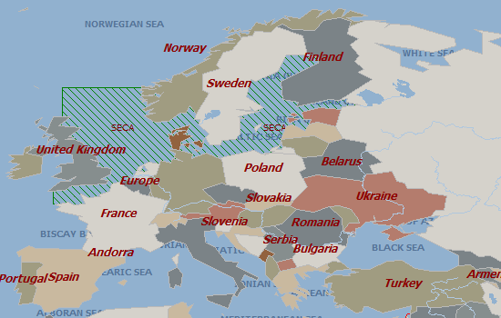
Local ECA : regulated by each country (SOx < 0.1%)

Slide 26
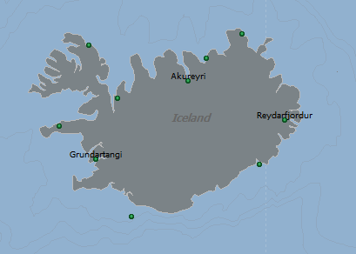
Iceland: All Ports

Slide 27
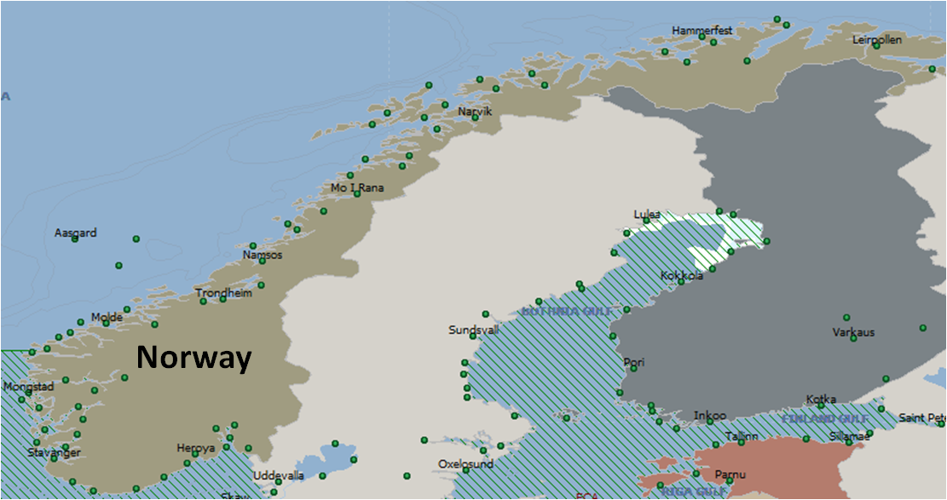
Norway: All Ports

Slide 28
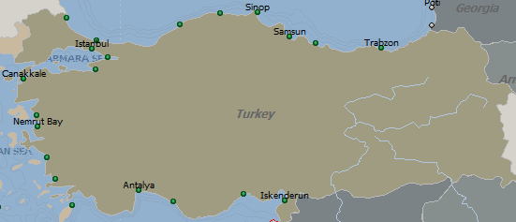
Turkey: All Ports

Slide 29
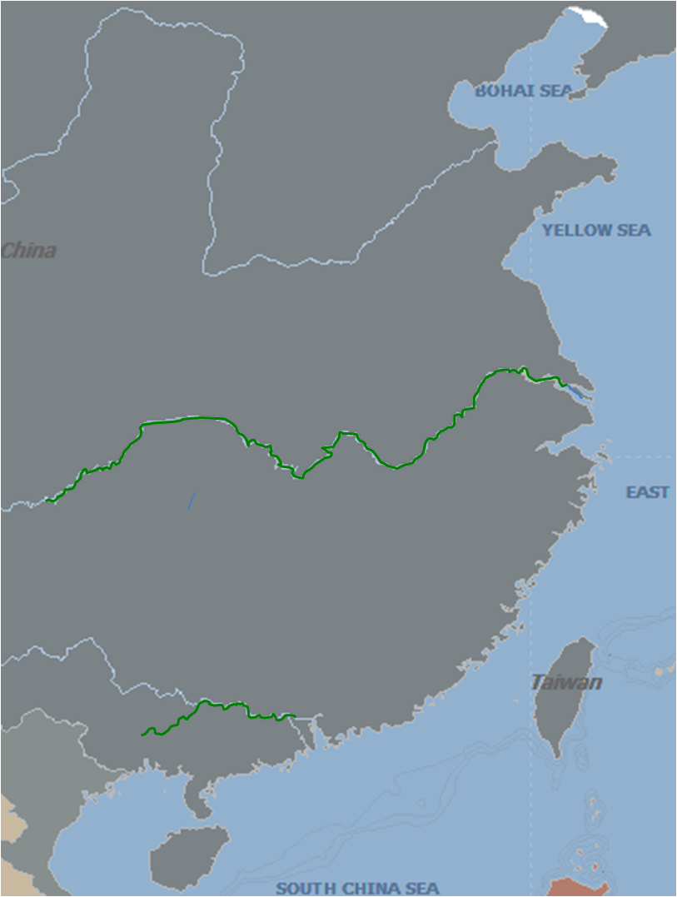
China Inland control areas

Slide 30
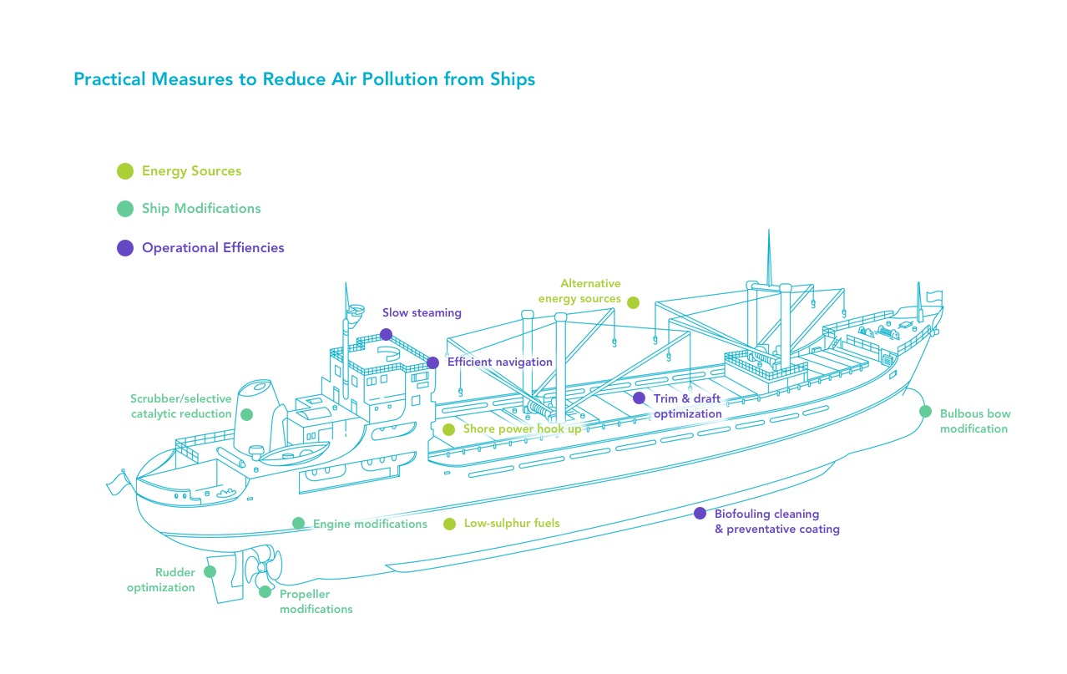

Slide 31
Energy Sources
Shore Power
Shore power is the process of providing electrical power from the shore to a ship while at a berth to shut off the ship’s auxiliary engines. Shore power reduces SO_{x}, NO_{x} and particulate matter emissions by 88% or more while in port and also reduces GHG emissions.

Slide 32
Low-sulphur Fuels
Besides use of Low Sulphur fuels, alternative energy sources being adopted are :
Liquefied natural gas (LNG) – Liquefaction removes water, oxygen, carbon dioxide and sulphur compounds from the natural gas for a fuel of mostly methane with some other hydrocarbons and nitrogen. This fuel produces lifecycle GHG emissions comparable to or sometimes higher than conventional marine fuels.,
Methanol – Liquid at room temperature, methanol is easier to store and distribute than LNG, but it increases lifecycle GHG emissions by 12-15% compared to conventional marine fuels.

Slide 33
Engine Modifications
Internal engine modifications – adding water, recirculating exhaust gas, cooling water temperatures, or modifying overlap timing or intake valve closing – can reduce NO_{x} emissions by nearly 100%.
Gas-fuelled engines can use LNG or methanol as fuel to reduce NO_{x} emissions by up to 90% and SO_{x} and particulate matter by 95% to 100% when compared to HFO.

Slide 34
Operational Efficiencies
Slow Steaming
Speed reduction effectively reduces fuel consumption and therefore air pollutants. A speed reduction of 5% in open-ocean conditions is associated with reported fuel savings of approximately 13% for bulk carriers or tankers and 16%-19% for container ships.
However, as ships may be operating outside of intended design parameters, this can potentially affect the function of the engines and propellers and consumption of lubrication oil.
Increase in travel time.

Slide 35
Vessel Cleaning and Coating
Live organisms ranging from algae and microbes to sea stars and mussels can attach themselves to ships’ hulls, propellers and other underwater components in a process known as biofouling.
This biological layer increases a ship’s resistance in water, increasing the fuel required to go an equivalent distance when compared to a clean ship. Research has estimated, depending on the thickness of the slime, a ship’s fuel consumption increases by 18% to 38%. Regular hull cleanings, either in-water or in dry dock, contribute to operating efficiency. Anti-fouling coatings can discourage build-up and reduce the frequency of hull cleanings.

Slide 36
Trim and Draft Optimization
Cargo distribution can influence the amount of resistance during a voyage. Ship operators can apply software to optimize cargo loading and increase fuel efficiency by 0.5% to 5%, depending on vessel type.
Efficient Navigation
Ship operators can navigate more economically by navigating to avoid sharp load increases on the engine and incorporating tide and current conditions to reduce propulsion demand through route optimization.

Slide 37
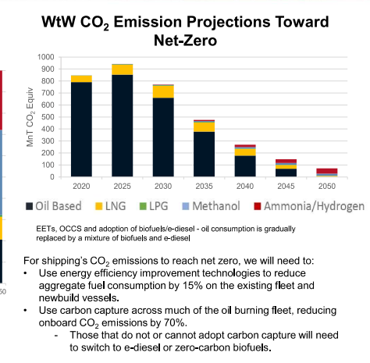

Slide 39
HYDROGEN
The International Maritime Organization (IMO) is developing regulations for hydrogen, with a tentative release date in 2025
Highly flammable Hydrogen is highly flammable and potentially explosive.
Challenging to store, To offer sufficient energy quantity, hydrogen must either be compressed or stored in liquid form at very low temperatures. This poses storage design challenges for ships.
Not yet widely available Green hydrogen is produced using renewable electricity.

Slide 40
Hydrogen Production
Different methods of hydrogen production:
Brown
Grey
Blue
Green
Green hydrogen production doesn’t require fossil fuels
Can be used as fuel or feedstock
© ABS

Slide 42
Thanks

