Slide 1
Ground Water Depletion – A Terrible Future Awaits Us
Dr. R. C. Srivastava
FNAAS, FISAE, FIASWC, FIE,FCHAI
Former Vice-Chancellor, RPCAU, Pusa, Bihar
Former Director, ICAR-CIARI, Port Blair
Former Director, ICAR- IIWM, Bhubaneswar

Slide 2
Water Situation of India
Total Water Availability : 4000 BCM (Billion Cubic Meter)
Green Water : 2169 BCM
Blue Water : 1831 BCM
Total Available Water : 1123 BCM
Surface Water : 691 BCM
Ground Water : 447 BCM (Exploitation about 60%)

Slide 3
Future Scenario of Ground Water Depletion
As the country becomes warmer, people will draw more water from underground, leading to faster depletion
India will be losing groundwater much faster, finds study
Across climate change scenarios, the researchers found that their estimate of groundwater level (GWL) declines from 2041 to 2080 is 3.26 times current depletion rates on average (from 1.62-4.45 times) depending on the climate model and Representative Concentration Pathway (RCP) scenario.

Slide 4
Impact of Ground Water Depletion
Reduction in availability of water. Already overall country is in stress situation with per capita water availability to about 1300 cu m against 1750 threshold level
Impact of Groundwater Decline on Energy Consumption and Pump Size
Pump Size Adjustments and Infrastructure Modifications
Fast Reduction in Lean Season Flow of Rivers
Impact on Earth Topography
Effect of depletion on ground water temperature
Effect of groundwater depletion on aquatic ecosystems
Effect of ground water depletion in coastal ecosystem
Socio Economic Impact of Groundwater Depletion
CAN THIS SITUATION BE REVERSED

Slide 5
Impact on Earth Topography
Latest study indicate that global groundwater pumping has caused our planet to tilt 31.5 inches.
It’s “like adding a tiny bit of weight to a spinning top.” However, question arises that How does groundwater pumping tilt the Earth? https://t.co/5Ebi8bnLMN — nature (@Nature) June 19, 2023 has reported that rampant pumping of water from underground reservoirs has shifted Earth’s geographic North Pole by more than 4 cm per year, and this is due to redistribution of groundwater impacting on the drift of the rotational pole.
Seo and his colleagues found that pumping shifted as much as 2,150 gigatons of water. This massive diversion of groundwater caused a shift in the Earth’s tilt. After all, the Earth spins on an axis, much like a top balances on a needle. Shifting a colossal amount of water makes the planet heavier on one side. Consequently, the Earth leans to one side by 31.5 inches, i.e., about 77 cm. It’s hard to comprehend such numbers, but they illustrate the impact of humanity’s water consumption.

Slide 6
Impact on Earth Topography
Another impact of excessive extraction of ground water is land subsidence, i.e., gradual sinking or settling of the Earth's surface.
When groundwater levels decline, especially in areas with certain soil types, the land above can collapse or settle, leading to long-term environmental, structural, and social impacts.
The mechanism of land subsidence due to ground water decline
Pore Pressure and Aquifer Support: Groundwater exists in the pores and fractures of subsurface soil and rock layers, providing support to the overlying land. When groundwater is extracted, the pore pressure (water pressure in the soil) decreases. In aquifers with clay or silt layers, the water helps keep the structure intact by supporting the soil particles and preventing them from collapsing.
Compaction of Soil Layers: Due to excessive pumping, the supporting water in these porous layers is removed leading to compaction of the soil or sediment layers and therefore decrease in land elevation.
Irreversible Compaction: Once the sediments compact, the process is largely irreversible. Even if the groundwater is recharged, the compacted soils do not return to their original structure, meaning that the land does not recover its previous elevation.

Slide 7
Impact on Earth Topography
This land subsidence damages infrastructure, can cause cracks in buildings, roads, bridges, and pipelines. Linear infrastructure viz., railways, highways are particularly susceptible to subsidence, as even minor shifts in land elevation can disrupt their functionality. Water, sewer, and gas lines may experience damage as the ground shifts and settles unevenly. Actually most of the time, these damages are attributed to poor workmanship as there is lack of awareness of damages due to depletion of ground water.
In hard rock aquifer areas, this land subsidence activates shifting of tectonic plates, which result in earthquake. The earthquake of Latur (Maharashtra) in 1993 is one such example where groundwater level had gone much below and it was in least sensitive zone

Slide 8
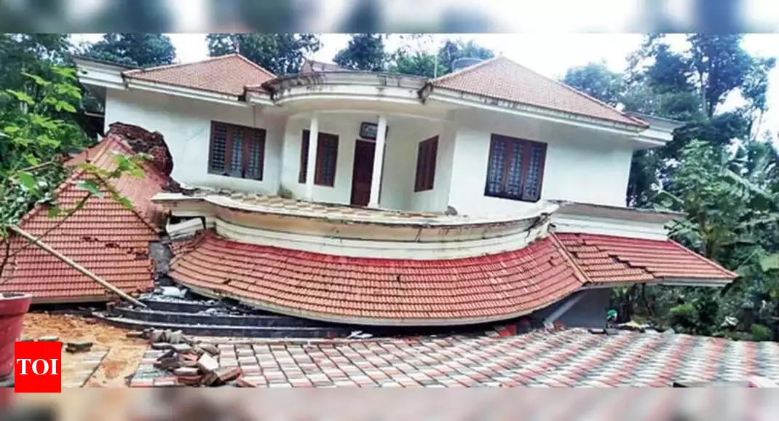
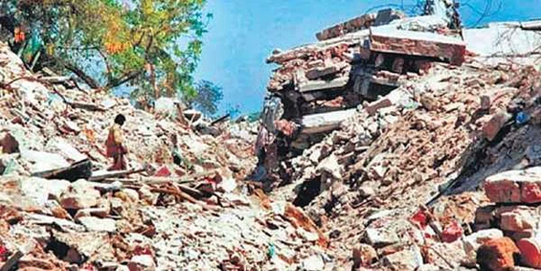
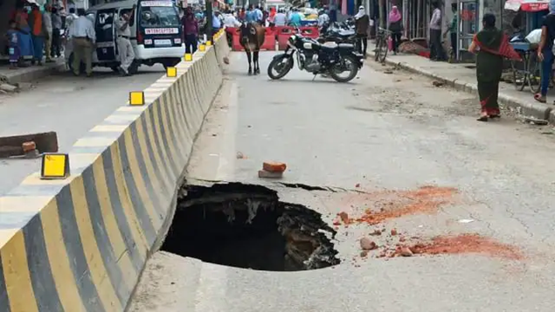

Damages due to land sinking (Pic from Google)

Slide 9
Few major examples of significant damage due to Land Subsidence caused by Groundwater Decline
Mexico City: One of the most well-known cases of land subsidence, Mexico City has been sinking for decades due to the over-extraction of groundwater. Parts of the city have sunk by as much as 10 meters over the last century, causing widespread damage to buildings, roads, and the city's drainage system.
San Joaquin Valley, California: In California’s agricultural heartland, intense groundwater pumping for irrigation has caused significant land subsidence, with some areas sinking by as much as 30 feet. This has damaged canals, bridges, and pipelines, and worsened the region’s water crisis.
Jakarta, Indonesia: The capital city of Indonesia is sinking at an alarming rate due to excessive groundwater extraction. The sinking of the city, combined with rising sea levels, makes Jakarta one of the most flood-prone cities in the world, leading the government to consider relocating the capital.
Houston-Galveston, Texas: This region has experienced substantial subsidence due to groundwater pumping for industrial and municipal use. Some areas have subsided by as much as 3 meters, increasing the risk of coastal flooding.

Slide 10
Impact of Land Subsidence
It is estimated that by 2040, land subsidence will affect about 8% of the world’s surface and about 1.2 billion inhabitants living in 21% of the major cities worldwide.
Like many other disasters, it is predicted that land subsidence will impact Asia more than other parts of the world. With 86% of the Asian population exposed to effects of land subsidence, about $8.17 trillion is potentially at stake.

Slide 11
Fast Reduction in Lean Season Flow of Rivers
Fast reduction in dry season flow of rivers is mostly viewed as effect of dwindling forest cover and change in land use of catchment area of river. However, only few attempts have been made to correlate it with declining groundwater levels.
Actually, rainfall intensity and duration, runoff, groundwater recharge, groundwater level and river flow are not separate factors but part of a continuum.
Unfortunately, no study on a model connecting all these factors could be found, while groundwater plays a critical role in maintaining the lean season (dry season) flow of rivers, streams, and rivulets, particularly in areas with unconsolidated aquifers. Unconsolidated aquifers, composed of loose materials such as sand, gravel, silt, and clay, are highly permeable and serve as natural reservoirs for water. They interact closely with surface water systems, contributing to baseflow

Slide 12
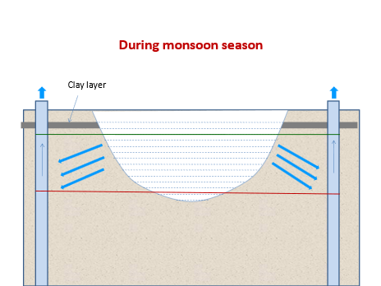
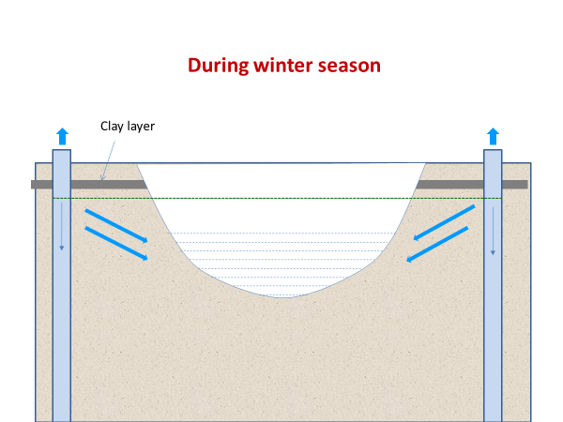
Impact on Lean Season Flow of Rivers

Slide 13
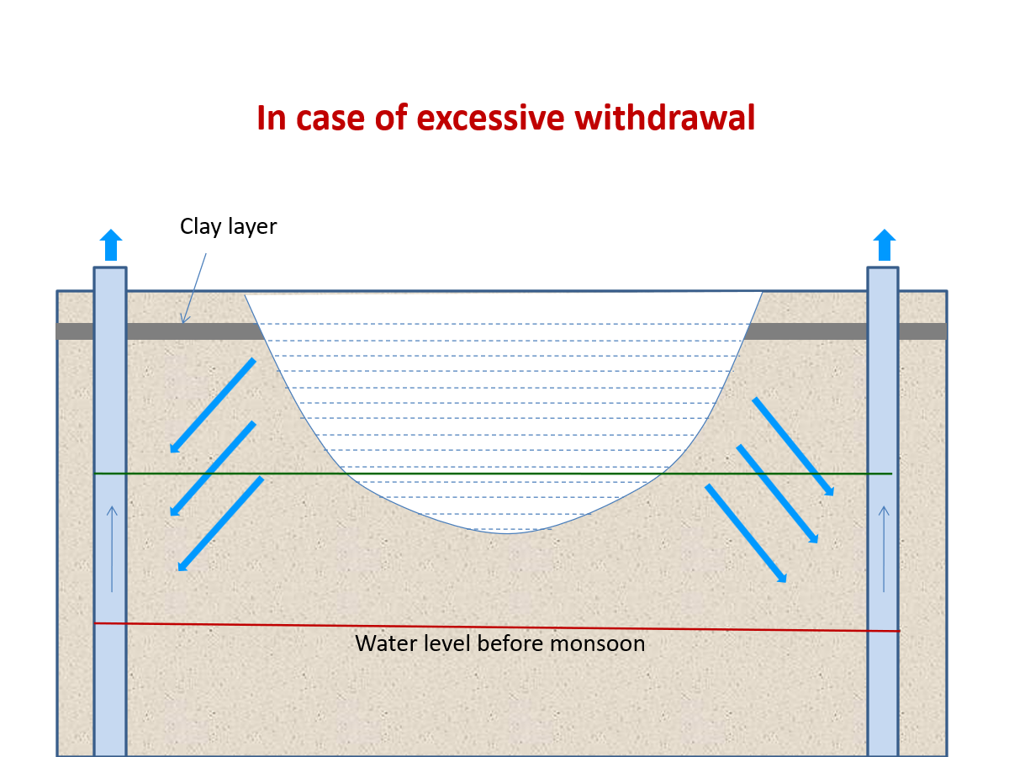
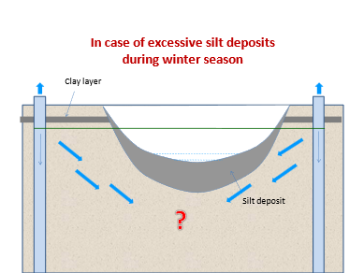
Impact on Lean Season Flow of Rivers Contd….

Slide 14
Effect of depletion on ground water temperature
Earth’s climatic system warms holistically in response to the radiative imbalance from increased concentrations of greenhouse gases. With a stable climate, seasonal temperature variation penetrates to a depth of 10–20 m, below which temperatures generally increase with depth in accordance with the geothermal gradient.
However, present-day borehole temperature–depth profiles frequently show an inversion (that is, temperature decreasing with depth) for up to 100 m due to recent, decadal surface warming. Deviations from steady-state subsurface temperatures in deep boreholes (for example, >300 m) have been used to evaluate terrestrial heat storage and to estimate past, pre-observational surface temperature changes at a global scale. Water temperature, sometimes known as the ‘master environmental variable’, is an understudied groundwater quality parameter in the context of climate change.
Groundwater temperature influences a suite of biogeochemical processes that alter groundwater quality. For example, an increase in temperatures reduces gas solubility and raises metabolism of organisms, with an increased rate of oxygen consumption and a shift in redox conditions.
Because many aquifers already possess low oxygen concentrations, a small change in temperature could trigger a shift from an oxic to a hypoxic or even an anoxic regime. This switch can in turn facilitate the mobilization of redox-sensitive constituents such as arsenic, manganese and phosphorus. Increases in soluble phosphorus in groundwater discharging to surface water can trigger harmful algal blooms, and elevated arsenic and manganese contents in potable water supplies pose direct risks to human health.

Slide 15
Effect of groundwater depletion on aquatic ecosystems
Ecosystems which need groundwater to survive are defined as groundwater-dependent ecosystems (GDE). These ecosystems are particularly sensitive to environmental change, but GDEs are poorly understood, and the complex underground architecture is especially difficult to study without invasive tools that could disrupt the delicate environment.
Many of these ecosystems are now under threat, according to a new study which expect that by 2050 more than half of the regions with groundwater abstractions will not be able to maintain healthy ecosystems. By an estimate almost 20% of the regions where groundwater is pumped currently suffer from a reduction of river flow, putting ecosystems at risk. This risk will intensify further and it is expected that by 2050 more than half of the regions with groundwater abstractions will not be able to maintain healthy aquatic ecosystem.

Slide 16
Effect of groundwater depletion on aquatic ecosystems
Groundwater depletion can cause large bodies of water to become shallower. Groundwater shortages prevent additional water from flowing into lakes, rivers, and seas. When groundwater levels are lower, there is less water to dilute pollutants, which can lead to a deterioration in groundwater quality.
The energy required to pump water from deeper levels can increase carbon emissions, which contributes to climate change. Groundwater depletion can reduce the cooling effect of groundwater on land and atmosphere, which can increase the risk of heat-related illnesses.
Another dimension about ecosystem is about nutrients especially nitrogen movement getting affected by ground water depletion. Beneath a streambed lies the hyporheic zone, where stream water and groundwater meet and mix. This mixing allows dissolved materials—such as oxygen, nitrogen, and other nutrients—to cycle between the stream and the hyporheic zone, influencing biological processes and water quality.
Rising or falling groundwater can reduce the circulation of water between the stream and the hyporheic zone. It has also been reported that groundwater also reduces the hyporheic zone’s ability to remove stream nitrate by denitrification, allowing more nitrogen to escape downstream, where it can harm human and ecosystem health.

Slide 17
Effect of ground water depletion in coastal ecosystem
Ground water depletion in coastal region has a totally different scenario than inland ecosystem, because any disturbance in this interface creates an imbalance in ecosystem. These ecosystems, that are often maintained by direct or indirect groundwater supplies, are called coastal groundwater dependent ecosystems (GDEs). Coastal lagoons and surrounding wetlands “groundwater-dependent ecosystems” (GDEs) and can be “coastal GDEs". Lack of surface water and the over-development of anthropogenic activities critically threaten the sustainability of coastal GDEs and associated ecosystem services.
The transdisciplinary approach between hydrogeology, hydrology, social sciences and law is essential to fully understand the socio-economic and environmental complexity of coastal GDEs. Priority must now be given to the development of an appropriate definition of coastal GDEs, based on a consensus between scientists and lawyers.

Slide 18
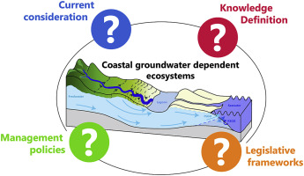
Effect of ground water depletion in coastal ecosystem
The transdisciplinary approach between hydrogeology, hydrology, social sciences and law is essential to fully understand the socio-economic and environmental complexity of coastal GDEs. Priority must now be given to the development of an appropriate definition of coastal GDEs, based on a consensus between scientists and lawyers.
Graphical abstract of Groundwater Dependent Ecosystem for Coastal region

Slide 19
CAN THIS SITUATION BE REVERSED
The situation is still reversible, if we take proper action, although in few areas it has gone beyond reversal. The success of reversing groundwater depletion depends on the severity of the depletion, local geological and climatic conditions, and the commitment of stakeholders to implement sustainable practices. Reversing groundwater depletion is a gradual process and requires collective effort across sectors. With a combination of science, technology, governance, and community action, it is possible to restore balance to groundwater systems.
Some approaches to reverse or mitigate groundwater depletion:
  Sustainable water management
  Artificial recharge and rain water harvesting
  Improved agricultural/irrigation practices
  Urban and Industrial Measures
  Policy and governance including community participation

Slide 20
Water Positive Approach – RPCAU experience

Slide 21
“We should not forget water cycle and life cycle are one”
THANK YOU…

