Slide 1
The Institution of Engineers (India)
UP State Centre Lucknow
Driverless Metro Train Operation
By
M. Alam
On
31st May 2025

Slide 2
Overview
Status of Metro Trains in India
Cost of Metro Network
Status of Metro Works in UP
Type of Train Operation
Safety in Metro Trains
DMI Operation
Wayside Architecture
Onboard Architecture
ATC Main Role
Onboard ATC
Driverless Metro Train Operation in India
Driverless Metro Train Operation around world
Question & Answers

Slide 3
Status of Metro Trains in India
Oldest Metro: Kolkata Metro started on 24 October 1984
Working Metros: Delhi Metro, Kochi, Lucknow, Kanpur, Agra, Noida, Bangalore, Hyderabad, Ahmedabad, Mumbai, Pune.
Metro Work in Progress/Extension: Surat, Bhopal, Indore, Meerut, Mumbai, Agra, Kanpur, Lucknow, Nagpur, Vijayawada, Kozhikode, Visakhapatnam, Patna, Guwahati, Varanasi & Kolkata
Biggest Metro Network: Delhi is 395 Kms with 10 lines and 289 stations with 46.3 Lakhs average daily passengers

Slide 4
Cost of Metro Network
Lucknow Metro total cost from CCS Airport to Munshipulia (22.878 Km): INR 6928 Crores, Average about INR 302.82 Crore per Km
Elevated line: INR 250 – 300 Crores per Km
Underground line: INR 500 – 600 Crores per Km
At Grade line: INR 150 – 200 Crores per Km
Cost of a 3 Coach Train: INR 21 Crores, Average INR 7 Crore per coach
Cost of Signalling System: INR 8.69 Crores per Km

Slide 5
Status of Metro Works in UP
Lucknow Metro:
CCS Airport to Munshipulia (22.87 Km), N-S Corridor-Phase-1: Commissioned on 5 Sept 2017, Phase -2: Commissioned on 9 March 2019.
Charbagh to Vasant Kunj (11.5 Km): Sanctioned at a cost of 5800 Crores, work shall start soon
Kanpur: Orange Line: IIT Kanpur to Motijheel (9 Km) commissioned in December 2021. Motijheel to Kanpur Central (7 Km) has been inaugurated by PM on 30th May 2025. Blue Line: 8.6 Km
Agra: Commissioned in Taj East Gate to Mankameshwar section (6 Km). Yellow line -14.27 Km, Blue line - 15.40 Km
Meerut: In progress, shall be commissioned by NCRTC along with Delhi – Meerut RRTS route. 2 Sections of 23.6 Km and 15 Km.
Noida: Working in Noida to Greater Noida section (29.7 Km) having 21 stations since 25 Jan 2019

Slide 6
Type of train Operation
Manual Operation:
Trains are run by the driver
Driver is fully responsible for safe operation
No technical aid is provided except Signals at the station
Semi Automatic Train Operation:
Trains are protected by Automatic Train Protection System (ATP)
Driver dives the train observing the speed restrictions and in case the speed exceeds the limit, brakes shall apply automatically.
He is also responsible for performing emergency duties

Slide 7
Type of train Operation
Automatic Train Operation:
Trains are protected by Automatic Train Operation System (ATO)
Driver is responsible for start of the train after ensuring that passengers have boarded and gates are closed
Train runs automatically without intervention of the driver
Driverless Train Operation:
Trains are protected by Unattended train Operation System (UTO)
Trains are fully protected technically and monitored by the Operation Control Centre (OCC)
Driver is not required in the train

Slide 8
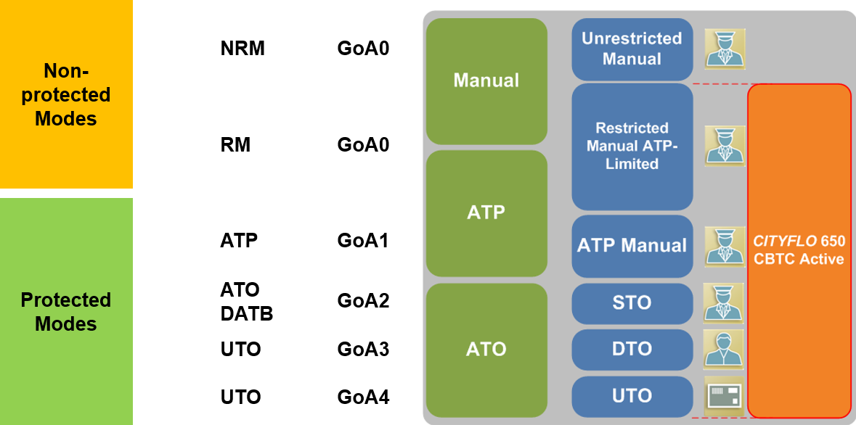
Type of Train Operation

Slide 9
Safety in Metro Trains
Now a days State of the Art Signalling System ‘Communication Based Train Control System (CBTC)’ is being used
Train are programmed with Safety Software
Safety Software meets the Safety Integrity Level-4 (SIL-4) and is certified by the OEM and the Independent Safety Assessor (ISA)
Trains control the speed automatically at the stations, curvature, bridges and turn outs and follows defined track speed
Trains apply brake and stop automatically at the stations, behind a leading train and in case of head on as well
Train stopping accuracy is (+) 1.5 and (-) 0.5 meters in ATP mode and (+_) 0.5 meters in ATO mode of operation
Train headway is designed for 90 Seconds

Slide 10
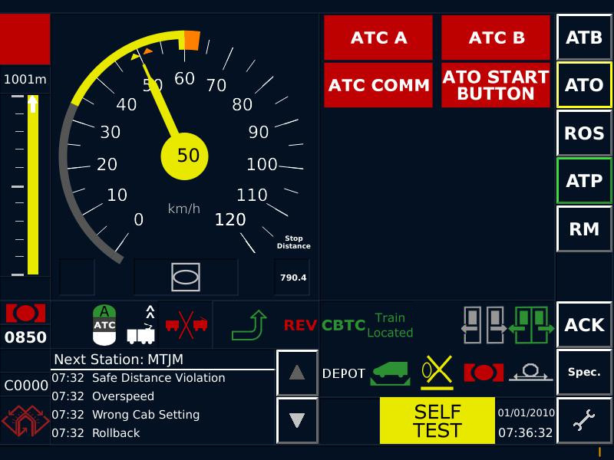
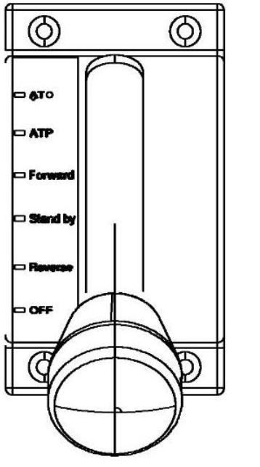
DMI Operation
VATC Operating Modes: DATB (Driverless Automatic Turn Back)
Mode indicator shown on DMI
The train driver acknowledges this transition by pressing an ATB button on the DMI.
When the arrival platform and the departure platform are the same, automatic turnback at a station platform (DATB mode) is applied.
The DMI indicates to the train driver once the DATB mode has been requested. The train driver acknowledges this transition by pressing an ATB button on the DMI.
Mode Selector Switch in ‘ATO’ position

Slide 11
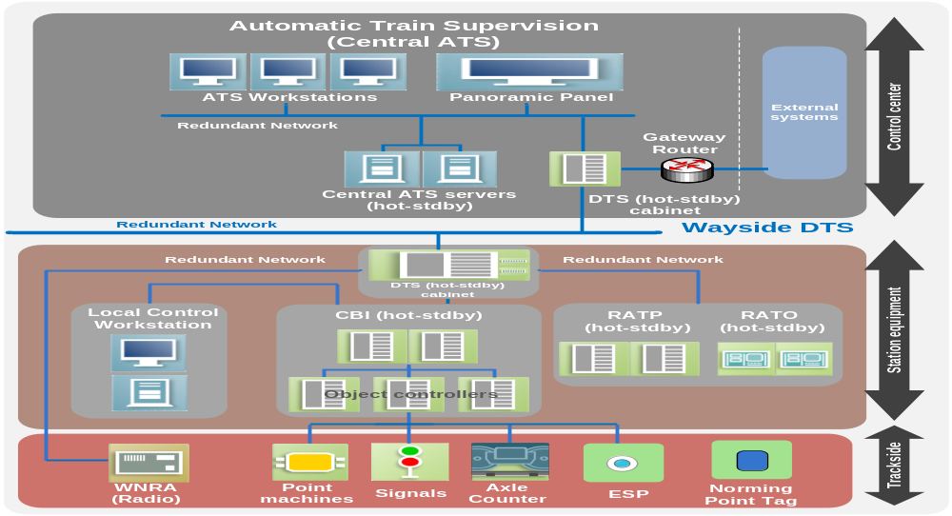
Wayside Architecture

Slide 12
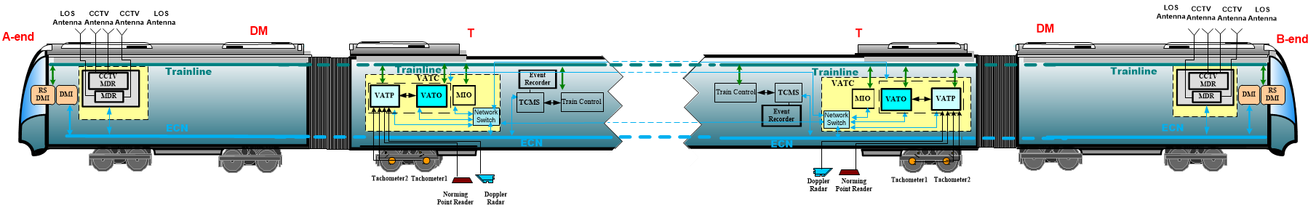
Onboard Architecture

Slide 13
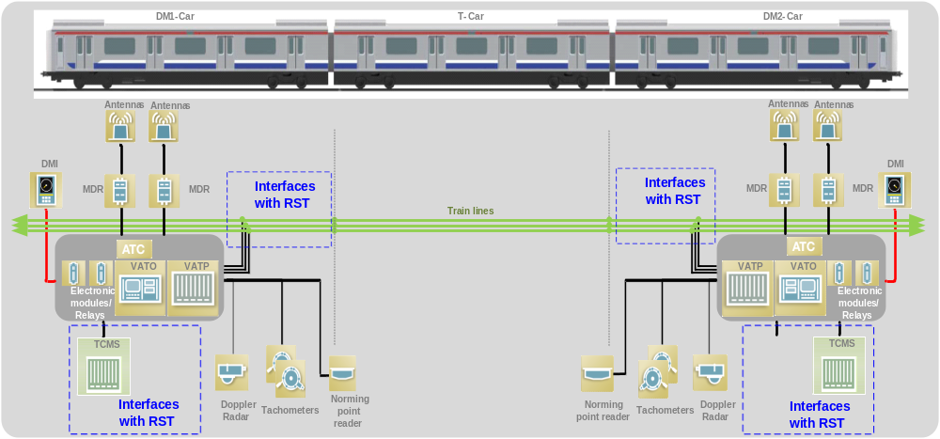
Onboard Architecture

Slide 14
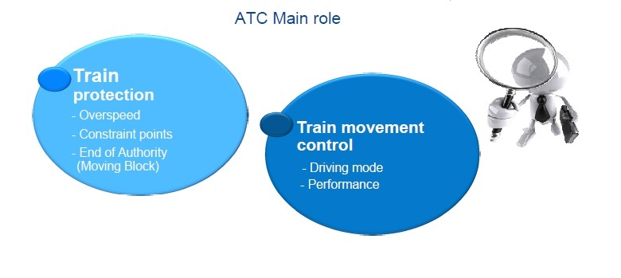

Slide 15
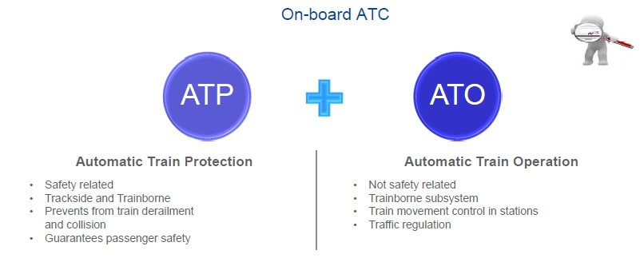

Slide 16
Driverless Metro Train Operation in India
Working System:
Delhi Metro Magenta Line (Janakpuri West to Botanical Garden) – December 2020
Delhi Metro Pink Line (Majlis Park to Shiv Vihar) – November 2021
Under Construction:
Bengaluru Namma Metro Yellow line (19 Km): Planned to be operational by end of 2025.

Slide 17
Driverless Metro Train Operation in the World
Riyadh Metro in Saudi Arabia: World longest fully automated driverless metro system is 176 Km long, having 6 lines and 85 stations.
Dubai Metro
London Victoria Line
Paris Line 14
Germany
Singapore
Jakarta

Slide 18
Driverless Metro Train Operation
Question & Answers

Slide 19

Thank You

