Slide 1


Safe Banking Happens with
Secure Banking

Slide 2
About – International Fraud Awareness Week
International Fraud Awareness week is a yearly campaign which the bank supports
Objective: Raise awareness about Fraud by promoting anti-fraud awareness and education
Target: Law Enforcement Agencies, Senior Citizens, Customers, Partners, Students etc.
Encourage Leaders, LEA, Influencers & Employees to proactively take steps to minimize Fraud
Demonstrate our organization’s commitment to Preventing and Detecting Fraud
Bank has planned various Internal and External programs to spread awareness
For more info - Visit https://www.fraudweek.com/

Slide 3

Common Types of Cyber Frauds
Vishing
Skimming
Common
types of cyber frauds
Fake Helpline
Phishing
Smishing
Card Cloning

Slide 4

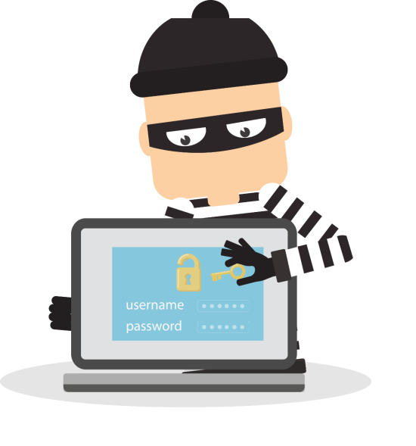

Common Types of Cyber Frauds
Phishing
Vishing
Smishing
Type of fraud that results in theft of personal data such as Customer ID, IPIN, Credit/Debit Card number, Card expiry date, CVV number etc.
When fraudsters try to seek personal banking data like Customer ID, Net Banking password, ATM PIN, OTP, Card expiry date, CVV etc. through phone call
Using mobile text messages to lure victims into calling back on a fake phone number, visiting fake websites or downloading malicious content via phone or web.
More Information:
https://www.hdfcbank.com/personal/useful-links/security
https://youtu.be/aSVY0l3nizA

Slide 5
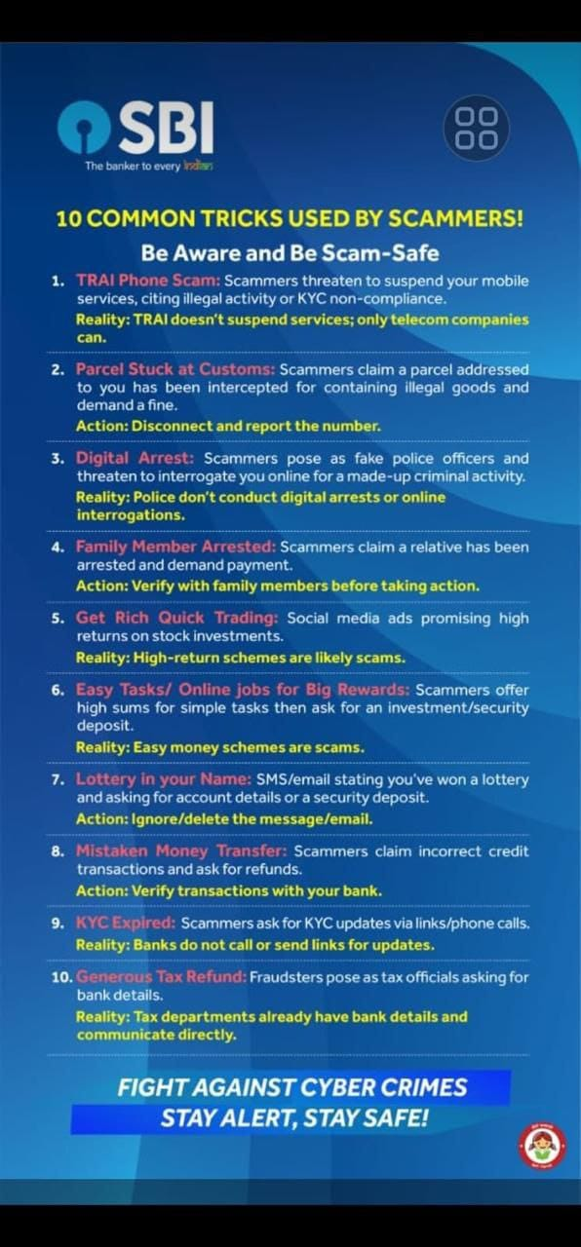

Slide 6

UPI Frauds
Pay and Collect Transactions approved by Customers using UPI PIN
How do fraudsters operate?
Fraudster call users and to draw attention, they represent themselves as the bank's representative
Then they try to scare you that your card, mobile banking will get blocked due to the ongoing issues in the App
Once hacker convinced you to believe their words, they ask to download an app to fix the problem
This app can be AnyDesk or Team Viewer any other remote device control app like it
Once downloaded the app or similar one, through next steps he can get access to your mobile screen and see all that you do
Under the pretext of helping he will also be able to view the Banking Credentials which he is asking you to type on the phone
Using banking credentials, like Debit card no., Expiry Date, UPI PIN he can then initiate transactions without your permission
How to protect yourself from fraud:
To prevent a UPI fraud, one need to make sure and be aware of the person behind that phone call asking you to download any app or share any confidential financial information
Also, if you receive any suspicious text message with a link or a phone number from a banking institution, you need to ignore it or visit your nearest bank branch to confirm it
Banks, credit card issuers or any financial institutions do not make such calls or send SMS of such nature
Also, try not to disclose your phone number especially on social media to avoid any UPI fraud transaction.
More Information:
https://www.hdfcbank.com/personal/useful-links/security
https://youtu.be/aSVY0l3nizA

Slide 7
Fake Helpline numbers
Helpline number obtained through searching on internet may not be genuine
How do fraudsters operate?
Customers seeking a solution to a problem do a Google search and call up a helpline number that has been updated by fraudster on Google
Most do not bother to look up the organization's website or the papers they may hold to locate the official phone numbers
Unaware, customers call on the fake helpline numbers that the fraudsters have updated
To resolve the issue, fraudsters ask customers to share banking information, like, card details and the OTP details received on their phone
As soon as customers share their card details, OTP, the money gets transferred from the customer’s account to the fraudster’s account.
How to protect yourself from fraud:
Helpline numbers online are not genuine.
You must visit the official website of the company for contact details
Never provide your personal details to anyone over the call.
No banks or reputed companies will ask you to provide your bank credentials over the phone
Don' t fall in the trap of such fraudsters
More Information:
https://www.hdfcbank.com/personal/useful-links/security
https://youtu.be/aSVY0l3nizA

Slide 8

SIM Swap Fraud
Under SIM Swap, fraudsters get a new SIM card issued against your mobile number, which they use
to get One Time Password (OTP) and alerts, required for making transactions through your bank account.
How do fraudsters operate?
Fraudsters get customer details like mobile number, A/c details through Phishing, Vishing, Smishing or DarkWeb
Fraudsters then manage to get a duplicate SIM Card for the same number belonging to customer
They send SMS (20 Digit SIM Number) to customer through SMS and ask them to forward the same to 121 (Cust Ser. Num) of the telecom operator, post which the customer’s mobile number gets deactivated and blank SIM in possession of fraudster gets activated.
Fraudsters then generate One Time Password (OTP), which is received on the new SIM card, to facilitate transactions.
How to protect yourself from fraud:
If your mobile no. has stopped working, check with your mobile operator to make sure you haven't fallen victim to SIM Swap.
Register for SMS and Email Alerts to stay informed about your account activities.
Regularly check your bank statements and transaction history for any irregularities.
More Information:
https://www.hdfcbank.com/personal/useful-links/security
https://youtu.be/aSVY0l3nizA

Slide 9

Skimming
A type of fraud in which the details on a debit/credit card are recorded and then transferred to a duplicate card. This is done without the knowledge of the original credit card holder.
How to protect yourself from fraud:
Do not share your card Debit / Credit card to anyone for processing transaction
Ensure your Debit / Credit card swiped in your the presence and the same is not used on any suspicious terminal
Check for any suspicious object at the ATM card insert slot
Please check if any camera is placed near to Keypad to avoid ypur PIN number being captured
Avoid taking assistance from any stranger at the ATMs and ensure no one is able to see your PIN number
Change your Debit / Credit card Pin at regular intervals
More Information:
https://www.hdfcbank.com/personal/useful-links/security
https://youtu.be/aSVY0l3nizA

Slide 10
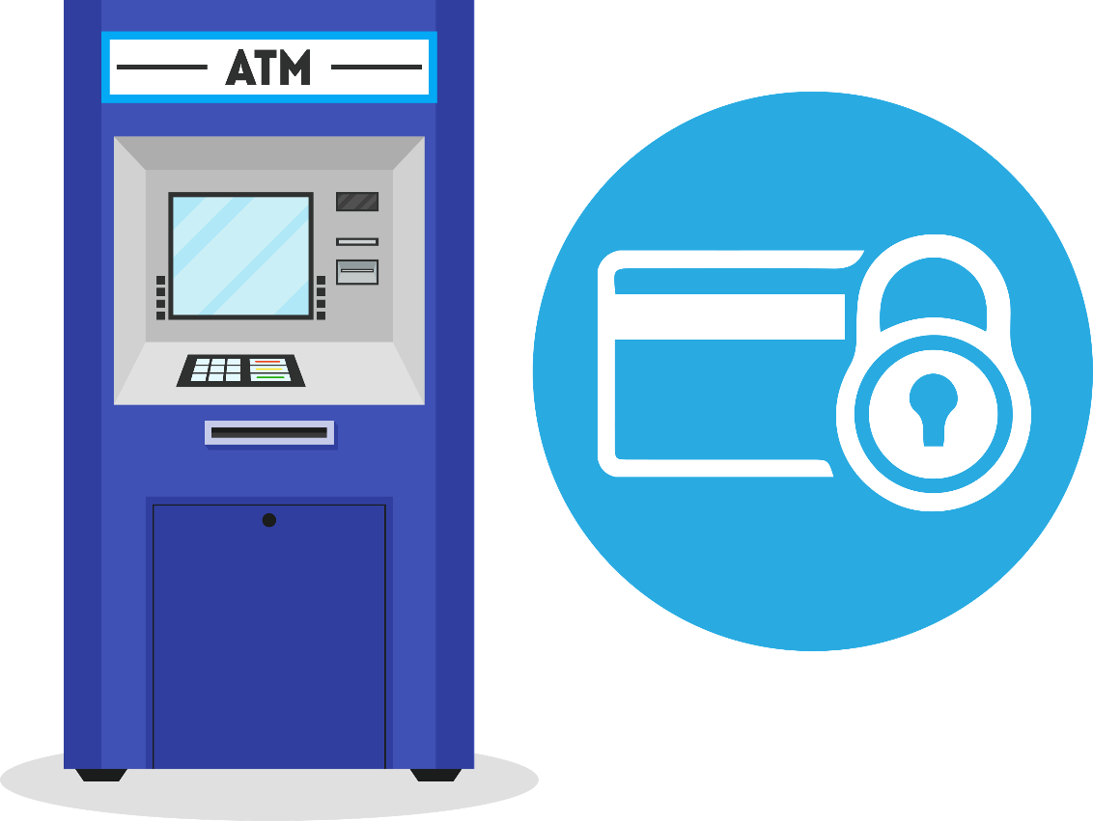
Secure ATM Banking
Memorize your PIN. Do not write it down.
Do not share your PIN or card with anyone. Change your PIN regularly.
Use your body to shield the keypad as you enter the PIN at the ATM
Do not take help for using the ATM or handling cash.
Do not use ATM if you find any unusual device attached to it.
Wait for the welcome screen before moving away from the ATM. Take your card and transaction slip.
Shred any transaction slip immediately after use if not needed.
If your ATM card is lost or stolen, contact your bank immediately
If there is any discrepancy after you deposit a cheque or card into the ATM, contact your bank.
Register your mobile number with the Bank to get alerts for your transactions
If your card gets stuck in the ATM, or cash is not dispensed call your bank immediately
Any complaint about your ATM/Debit/Credit card transaction should be reported to the bank.
More Information:
https://www.hdfcbank.com/personal/useful-links/security
https://youtu.be/aSVY0l3nizA

Slide 11

Mobile Security
DO’s
Password protect the phone. Keep the max number of wrong password entries to three.
Create a strong password.
Check for any unauthorized transactions when reviewing account statements
Change your IPIN regularly
Immediately report loss of mobile phone to your service provider and police.
DONT’s
Never disclose your PIN or confidential details over the phone or internet.
Don’t click on links in emails/social networking sites claiming to be from the bank
Don’t transfer funds without validation of the beneficiary, transferred funds cannot be reversed
Don’t store sensitive information on your phone.
Inform the bank of change in your mobile no.to ensure SMS alerts are not sent to someone else
Never reveal any email or paper from the bank concerning the PIN or password
Be cautious with offers from caller tunes or dial tunes or email attachments from known/unknown sources
Be cautious when using Bluetooth in public places as someone may access your confidential information
Be careful while browsing the web. If a website doesn’t look authentic, close it immediately.
More Information:
https://www.hdfcbank.com/personal/useful-links/security
https://youtu.be/aSVY0l3nizA

Slide 12

Secure Net Banking Tips
Do not disclose your Customer ID and IPIN to anybody
Change your IPIN as soon as you receive it and memorize it
Avoid internet banking from cyber cafes or public Wi-Fi networks like hotels, airports etc.
Do not click on links in emails or sites other than www.hdfcbank.com to access Net Banking
Always visit the HDFC Bank's Net Banking site through HDFC Bank's home page by typing the bank's website address https://netbanking.hdfcbank.com in the address bar
Check the URL as to verify the Bank’s Net Banking page and the PAD Lock symbol at the top left of the browser
Disable "Auto Complete" feature on your browser
Uncheck "User names and passwords on forms", click on "Clear Passwords“ Click "OK"
Use virtual keyboard while logging into your internet banking account
Cross check your last login information available on Net Banking at every login to monitor any unauthorized logins
Always type in your confidential account information. Do not copy paste it.
Monitor transactions regularly using HDFC Bank's "InstaAlerts" service and notify the bank of any fraudulent activity
Always logout before closing the browser when exiting Net Banking
More Information:
https://www.hdfcbank.com/personal/useful-links/security
https://youtu.be/aSVY0l3nizA

Slide 13

Secure Online Shopping Tips
Always shop or make payments through trusted/reputed websites
Do not click on links in emails. Always type the URL in the address bar of the browser
Before entering private details, always check the URL of the site!
Frequent online shoppers should signup for Verify by Visa and Master Card secure code program
Check account statements regularly and notify the bank of any fraudulent transaction
Check for PAD LOCK symbol on the webpage before starting to transact
Do not enter your confidential account information in any pop-up windows
Using One Time Password received on the mobile is more secure than static Visa and Master card secure code
More Information:
https://www.hdfcbank.com/personal/useful-links/security
https://youtu.be/aSVY0l3nizA

Slide 14

Secure Internet Browsing Tips
Observe click discipline while browsing through different websites
You may land up clicking on to malicious link that could download malicious code / software or virus on to your computer
Downloading software from non-trustworthy sites including torrent sites may lead to infecting your computer with virus
Read privacy policy of the website before entering personal information such as name and email ID
Be aware of how your information would be used by the website owner
More Information:
https://www.hdfcbank.com/personal/useful-links/security
https://youtu.be/aSVY0l3nizA

Slide 15
Secure Banking Tips
For more information visit the below sites,
https://www.hdfcbank.com/personal/useful-links/security
Secure Banking Tips – Regional Language
  Tamil - https://youtu.be/jiaMjtUopaI
  Telugu - https://youtu.be/QeCJokJZFjU
  Kannada - https://youtu.be/7oUC-1-TyTE
  Malyalam - https://youtu.be/CB6dPmJwCxw
  Assamese - https://youtu.be/A60g6ecH3RQ
  Marathi - https://youtu.be/eEoBoxtKAS0
  Bengali - https://youtu.be/b0kw9Gn_8-U
  Gujarati - https://youtu.be/iWdeM4Ujq_Q
  Punjabi - https://www.youtube.com/watch?v=-Pt_Igv4Mek&feature=youtu.be
  Oriya - https://youtu.be/goaKG2xVmUQ
  English - https://youtu.be/aSVY0l3nizA
  Hindi - https://youtu.be/r1zdInHE0Gk

Slide 16
Thank You

